Slide 1
Gaussian Processes
Scientific Machine Learning
Sebastian Klein

Slide 2
Outline

Slide 3
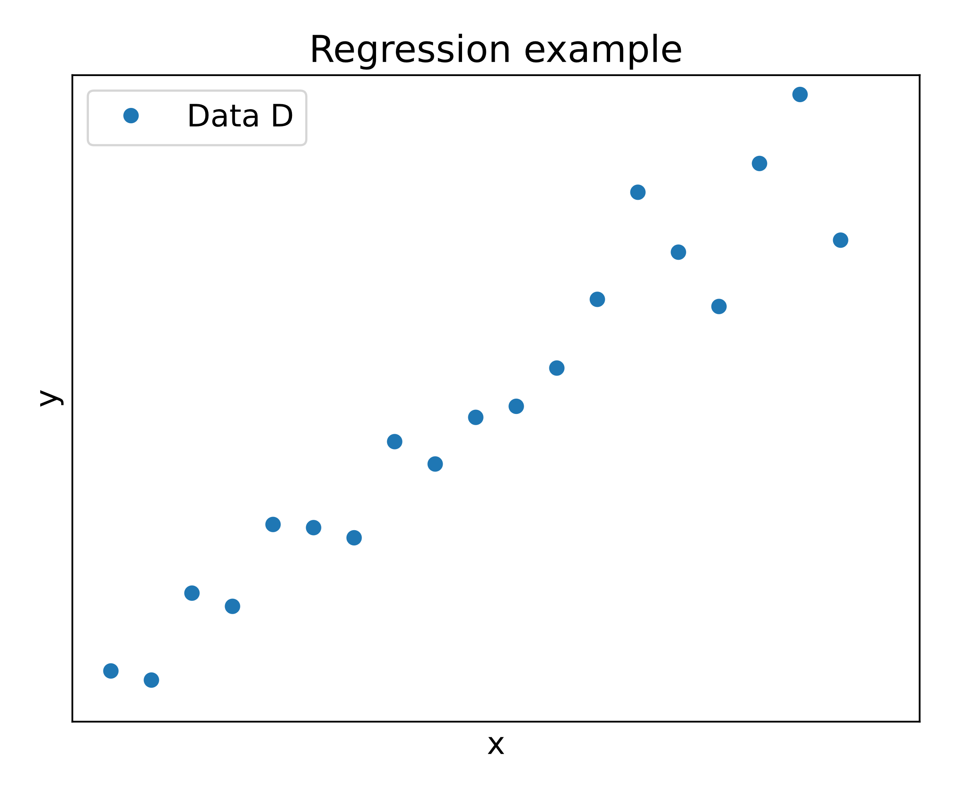
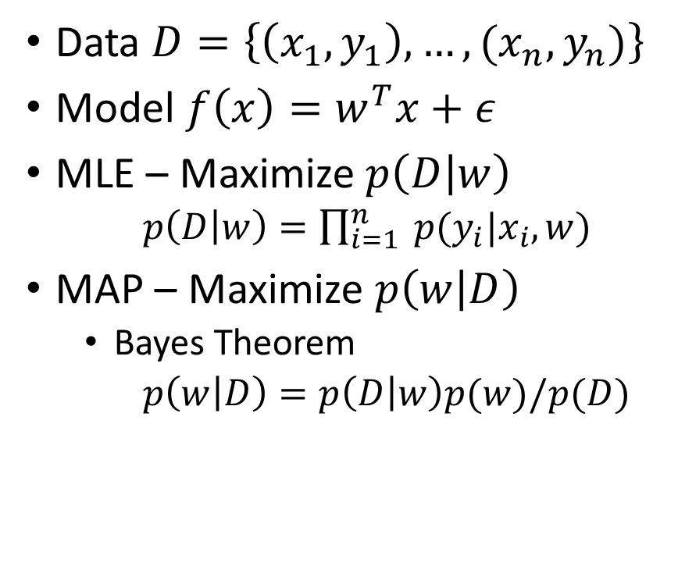
Motivation – Regression problems [1]
Data $D=\left\{\left(x_{1},y_{1}\right),…,(x_{n},y_{n})\right\}$
Model $f\left(x\right)=w^{T}x+ε$
MLE – Maximize$p\left(D | w\right)$
$p\left(D | w\right)=\prod_{i=1}^{n}{ p(y_{i}|x_{i}, w)}$
MAP – Maximize $p\left(w | D\right)$
Bayes Theorem
$p\left(w | D\right)=p\left(D | w\right)p(w)/p(D)$
Notes:
$w^{T}x+ε$ – epsilon = noise, w - model parameters
$p(y_{i}|x_{i}, w$) how likely is it that the x_i gives rise to the y_i with the parameter w
MLE - Maximum Likelihood Estimation - max probability of Data $p\left(D | w\right)$ for a parameter $w$
MAP- Maximum a posteriori

Slide 4
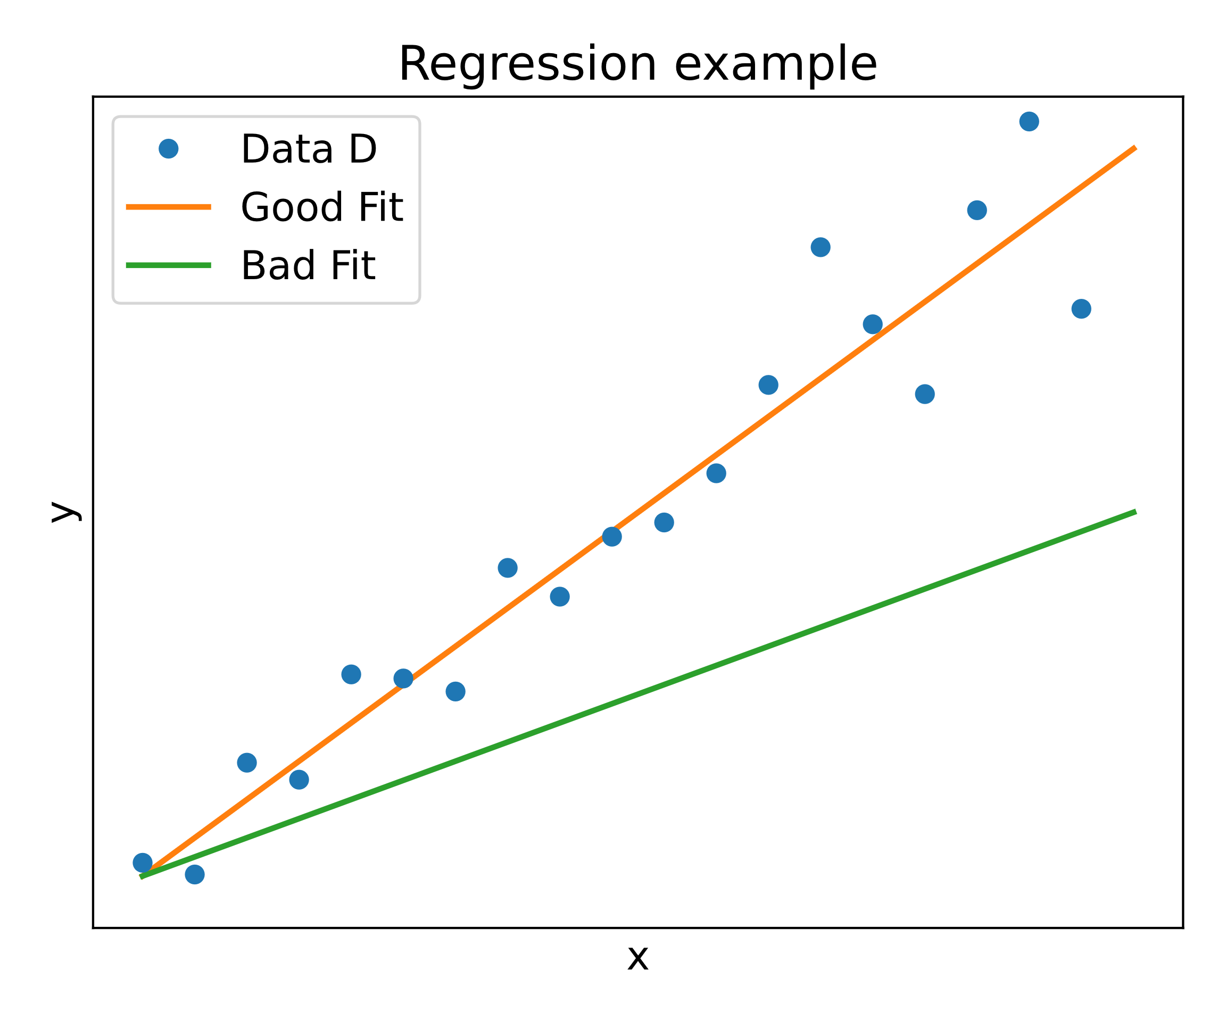
Motivation – Regression problems [1]
Data $D=\left\{\left(x_{1},y_{1}\right),…,(x_{n},y_{n})\right\}$
Model $f\left(x\right)=w^{T}x+ε$
MLE – Maximize$p\left(D | w\right)$
$p\left(D | w\right)=\prod_{i=1}^{n}{ p(y_{i}|x_{i}, w)}$
MAP – Maximize $p\left(w | D\right)$
Bayes Theorem
$p\left(w | D\right)=p\left(D | w\right)p(w)/p(D)$
Notes:
$w^{T}x+ε$ – epsilon = noise, w - model parameters
$p(y_{i}|x_{i}, w$) how likely is it that the x_i gives rise to the y_i with the parameter w
MLE - Maximum Likelihood Estimation - max probability of Data $p\left(D | w\right)$ for a parameter $w$
MAP- Maximum a posteriori

Slide 5
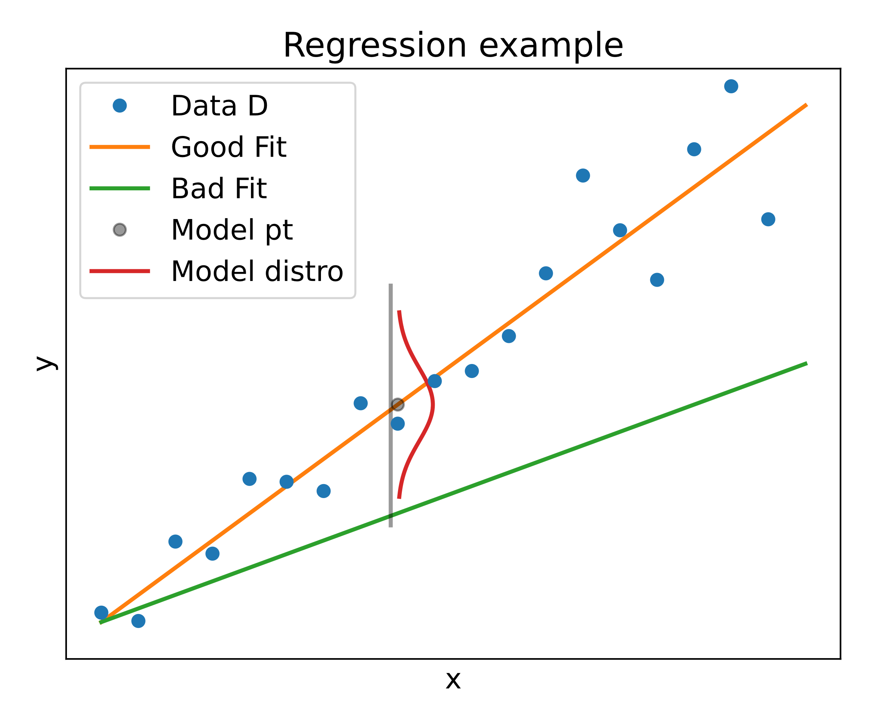
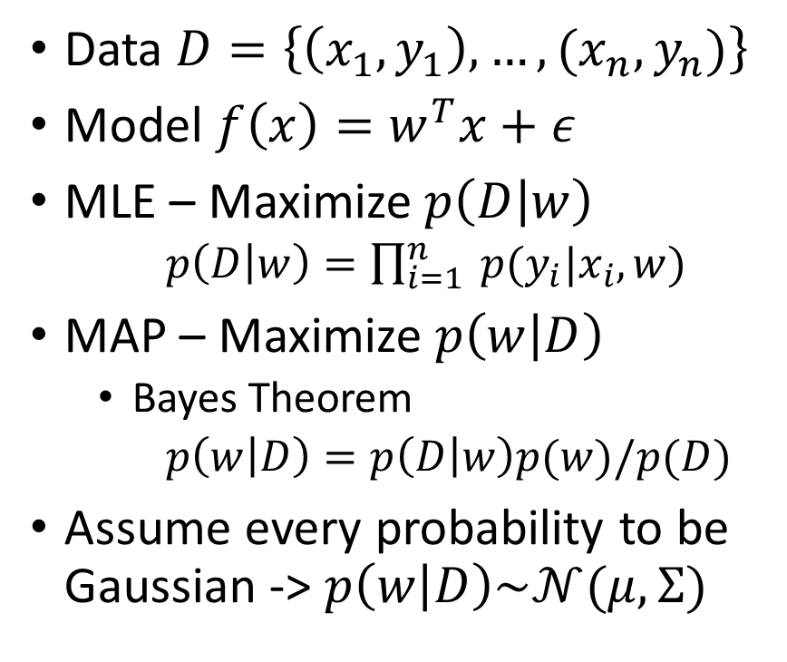
Motivation – Regression problems [1]
Data $D=\left\{\left(x_{1},y_{1}\right),…,(x_{n},y_{n})\right\}$
Model $f\left(x\right)=w^{T}x+ε$
MLE – Maximize$p\left(D | w\right)$
$p\left(D | w\right)=\prod_{i=1}^{n}{ p(y_{i}|x_{i}, w)}$
MAP – Maximize $p\left(w | D\right)$
Bayes Theorem
$p\left(w | D\right)=p\left(D | w\right)p(w)/p(D)$
Assume every probability to be Gaussian -> $p\left(w | D\right)\sim 𝒩(μ, Σ)$
Notes:
$w^{T}x+ε$ – epsilon = noise, w - model parameters
$p(y_{i}|x_{i}, w$) how likely is it that the x_i gives rise to the y_i with the parameter w
MLE - Maximum Likelihood Estimation - max probability of Data $p\left(D | w\right)$ for a parameter $w$
MAP- Maximum a posteriori
Assume Gaussian probability in MLE -> p
Last line -> How do we come to the conclusion $p\left(w | D\right)\sim 𝒩(μ, Σ)$

Slide 6
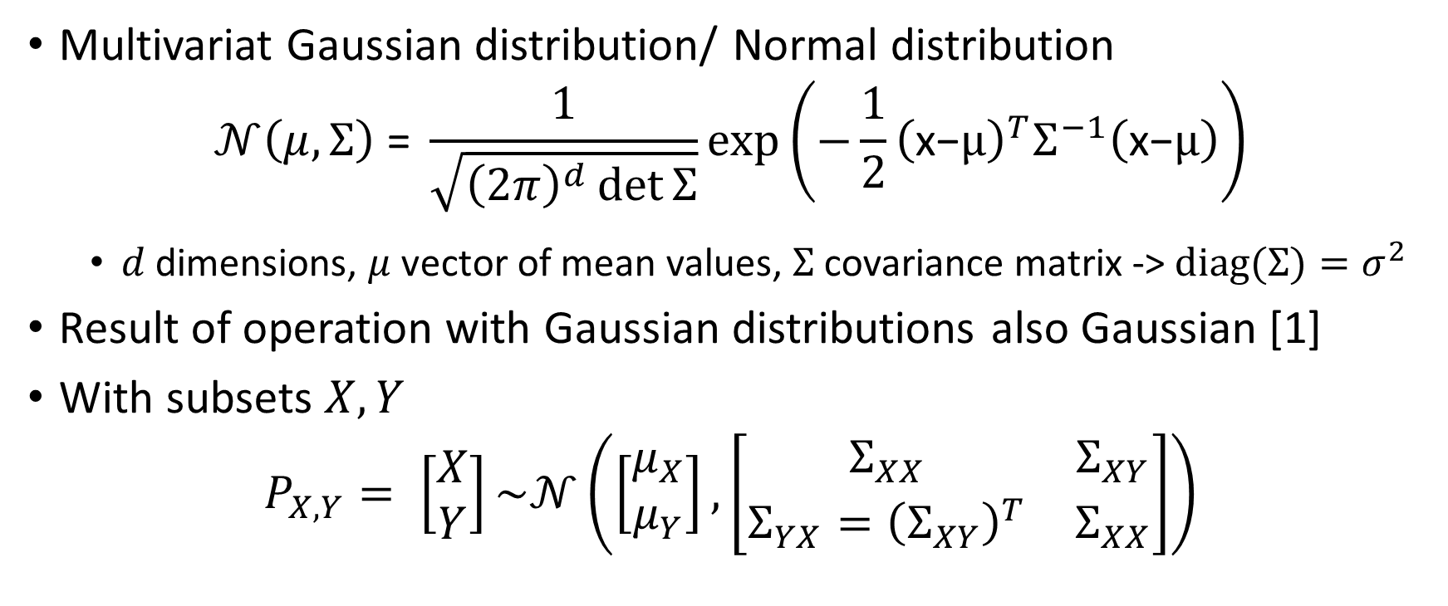
Intermezzo – Multivariate Gaussian[2]
Multivariat Gaussian distribution/ Normal distribution
$$𝒩\left(μ, Σ\right) \text{=} \frac{1}{\sqrt{{\left(2π\right)}^{d}\det{Σ}}}\text{exp}\left(−\frac{1}{2}{\left(\text{x}\text{−}μ\right)}^{T}Σ^{−1}\left(\text{x}\text{−}μ\right)\right)$$
$d$ dimensions, $μ$ vector of mean values, $Σ$ covariance matrix -> $diag(Σ)=σ^{2}$
Result of operation with Gaussian distributions also Gaussian [1]
With subsets $X,Y$
$$P_{X,Y}= \left[\begin{matrix}X \\ Y\end{matrix}\right]\sim 𝒩\left(\left[\begin{matrix}μ_{X} \\ μ_{Y}\end{matrix}\right],\left[\begin{matrix}Σ_{XX} & Σ_{XY} \\ Σ_{YX}={\left(Σ_{XY}\right)}^{T} & Σ_{XX}\end{matrix}\right]\right)$$
Notes:
$σ^{2}$ is the variance
$σ$ is the standard deviation
Marginalization and Conditioning operating on subsets

Slide 7
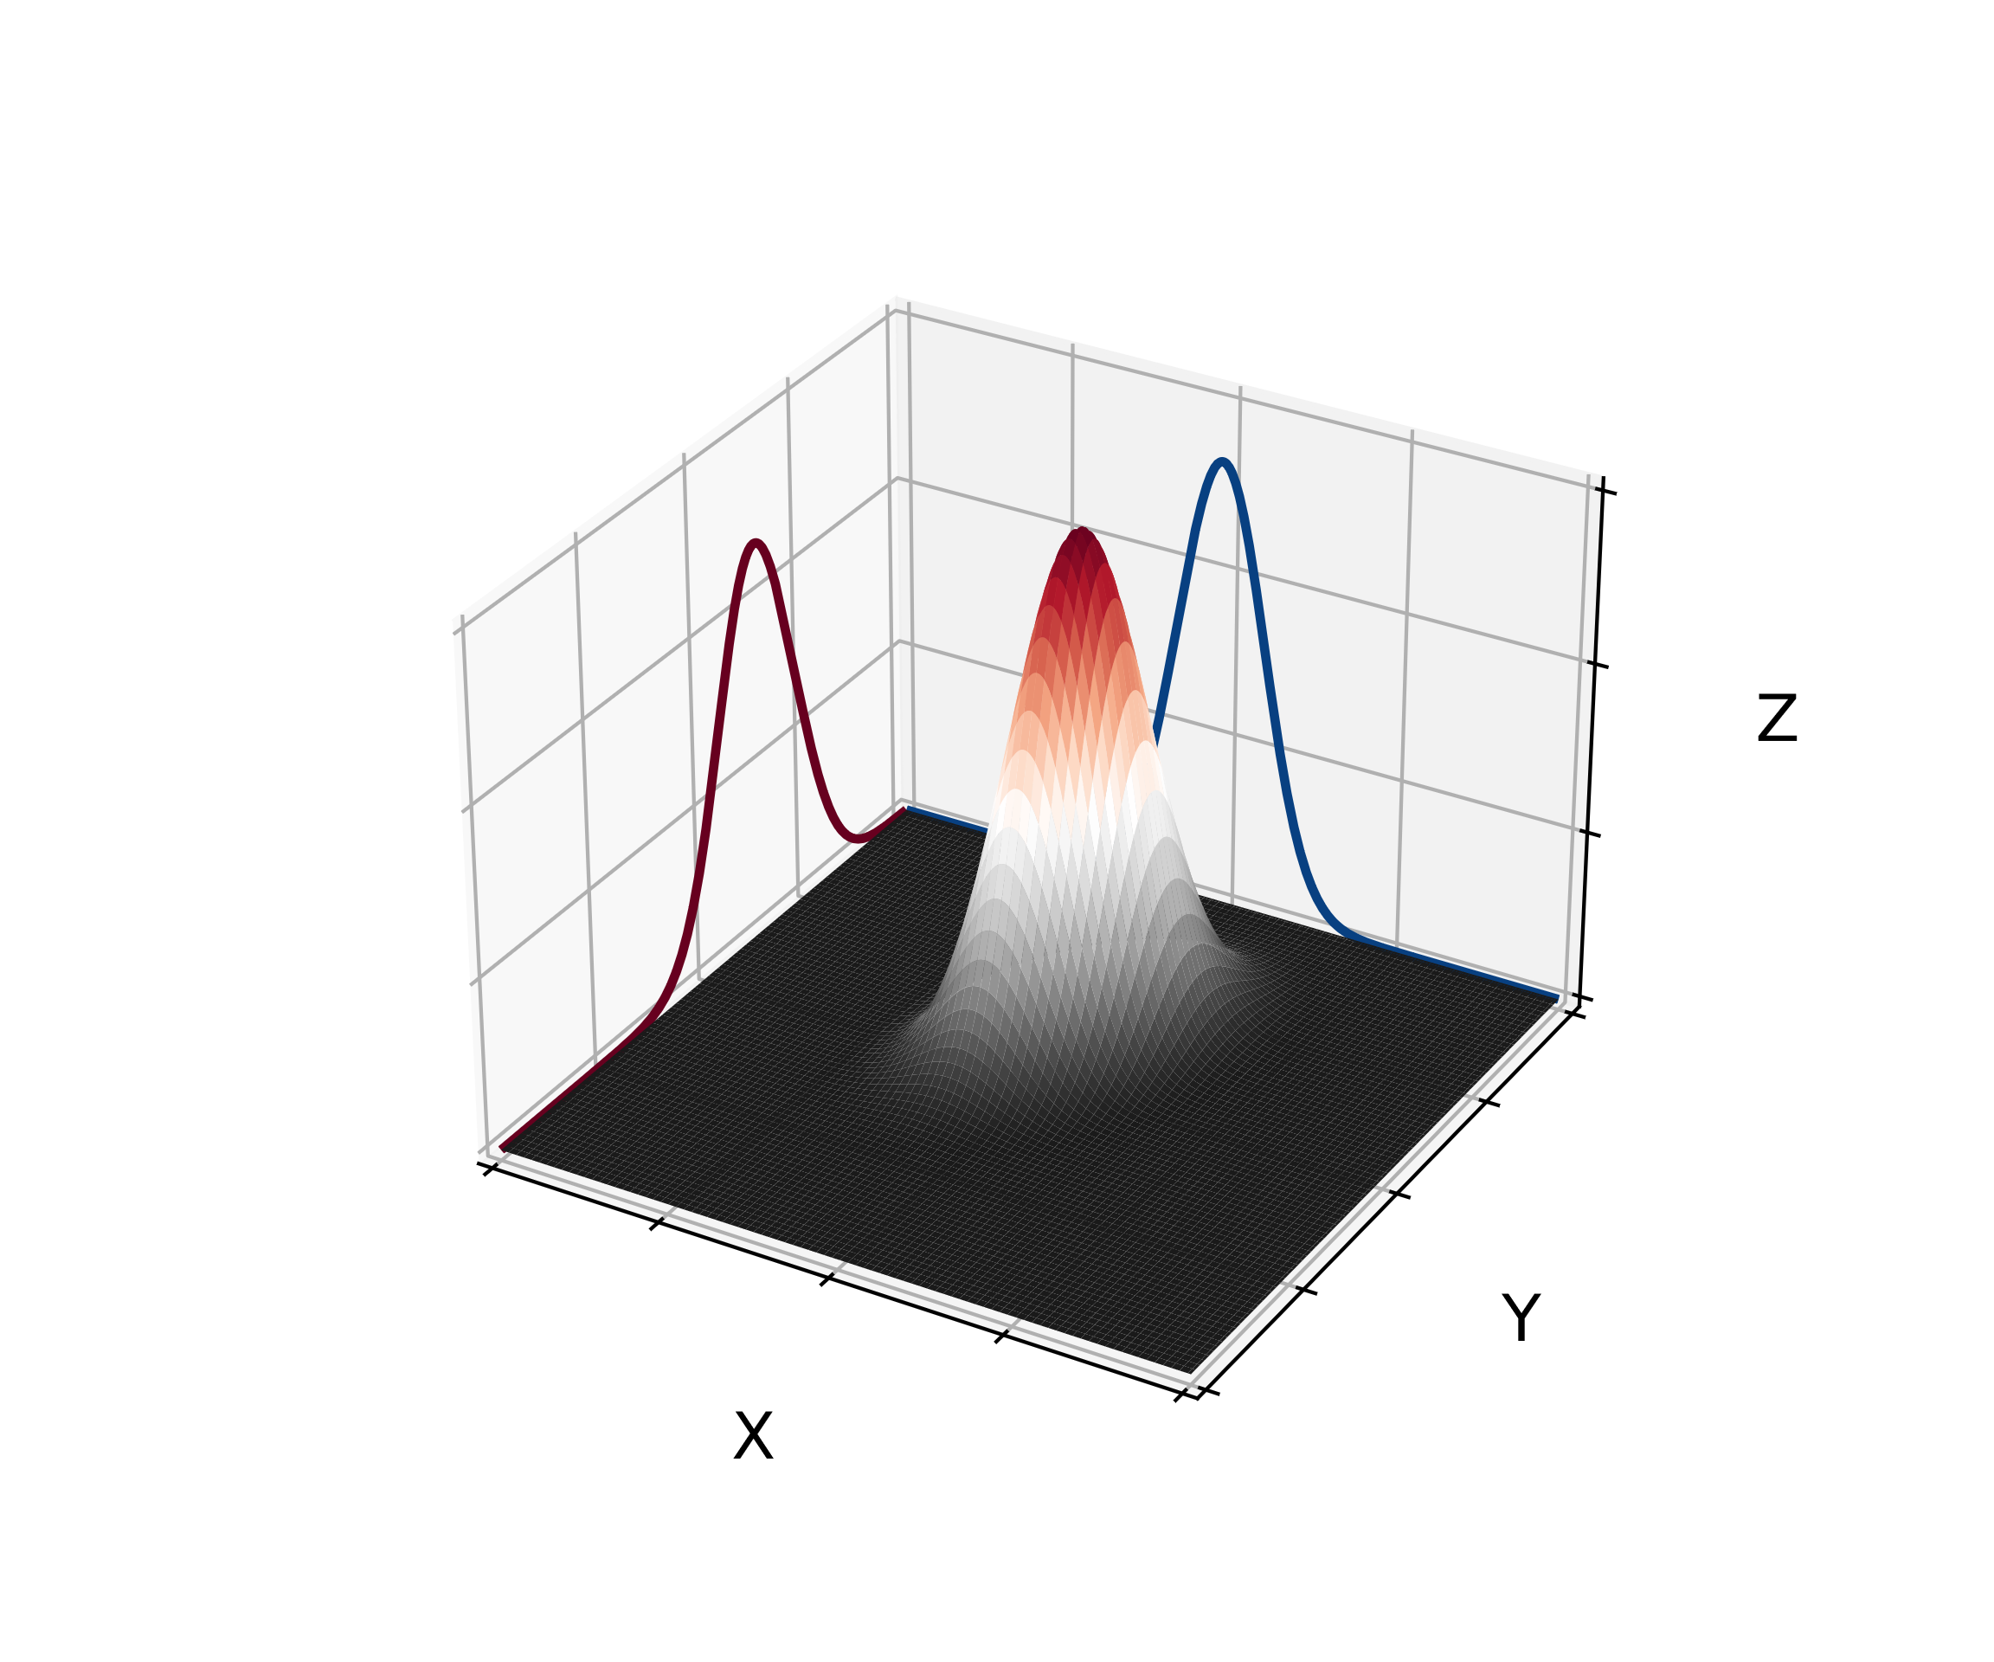
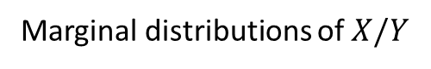
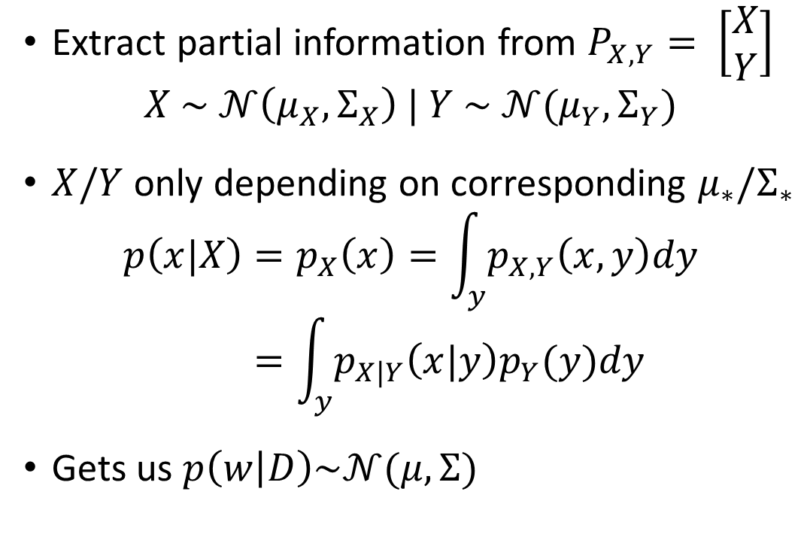
Intermezzo – Marginalization [2]
Extract partial information from $P_{X,Y}= \left[\begin{matrix}X \\ Y\end{matrix}\right]$
$$X \sim 𝒩\left(μ_{X},Σ_{X}\right) | Y \sim 𝒩(μ_{Y},Σ_{Y})$$
$X/Y$only depending on corresponding $μ_{∗}/Σ_{∗}$
$$p\left(x|X\right)=p_{X}\left(x\right)=\int_{y}{p_{X,Y}\left(x,y\right)dy} \\ =\int_{y}{p_{X|Y}\left(x|y\right)p_{Y}(y)dy}$$
Gets us $p\left(w | D\right)\sim 𝒩(μ, Σ)$
Marginal distributions of $X/Y$
Notes:
Marginalization tells us that the posterior distributioin p(w|D) is also gaussian distributed with some mean and some covariance matrix

Slide 8
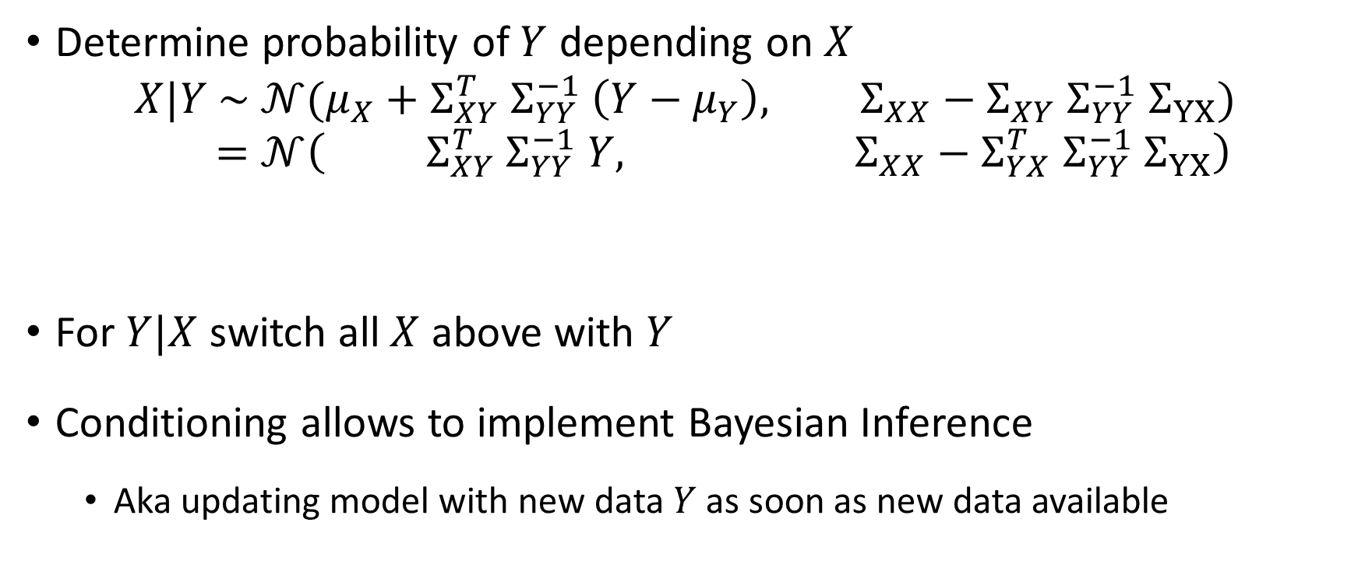
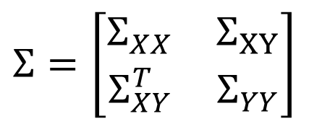
Intermezzo – Conditioning [2]
Determine probability of $Y$ depending on $X$
$$X|Y \sim 𝒩(μ_{X}+Σ_{XY}^{T} Σ_{YY}^{−1} \left(Y−μ_{Y}\right), Σ_{XX}−Σ_{XY} Σ_{YY}^{−1} Σ_{YX}) \\ =𝒩\left( Σ_{XY}^{T} Σ_{YY}^{−1} Y, Σ_{XX}−Σ_{YX}^{T} Σ_{YY}^{−1} Σ_{YX}\right)$$
For $Y|X$ switch all $X$ above with $Y$
Conditioning allows to implement Bayesian Inference
Aka updating model with new data $Y$ as soon as new data available
Mean
Covariance Matrix
$$Σ=\left[\begin{matrix}Σ_{XX} & Σ_{XY} \\ Σ_{XY}^{T} & Σ_{YY}\end{matrix}\right]$$
Notes:
(or vice versa) conditioning
Cornerstone of GP
Last line assume $μ_{Y}=0$

Slide 9
Regression as Gaussian Process (GP) [2]
How to predict values?
Know $p\left(w | D\right) \sim 𝒩(μ, Σ)$
Know 𝑝(𝑤│𝐷) ~ 𝒩(𝜇, Σ)
What is a prediction here?
Sample drawn from $𝒩\left(μ, Σ\right)$
Sample drawn from 𝒩(𝜇, Σ)
How get $𝒩(μ, Σ)$?
How get 𝒩(𝜇, Σ)?
Learn with training data $Y$
Learn with training data 𝑌
Predict value for test data $X$
Predict value for test data 𝑋
How to determine $μ$ and $Σ$?
How to determine 𝜇 and Σ?
Set $μ=0$
Set 𝜇=0
Simplifies conditioning to $X|Y \sim 𝒩\left(0, Σ_{XX}−Σ_{YX}^{T} Σ_{YY}^{−1} Σ_{YX}\right)$
Simplifies conditioning to 𝑋|Y ~𝒩(0, Σ_𝑋𝑋−Σ_𝑌𝑋^𝑇 Σ_𝑌𝑌^(−1) Σ_YX )
Characteristic of $𝒩(μ, Σ)$ determined solely by $Σ$
Characteristic of 𝒩(𝜇, Σ) determined solely by Σ
Notes:
Later we can add back $μ≠0$

Slide 10
Regression as Gaussian Process [2]
Last result
How to determine the $Σ$’s?
How to determine the Σ’s?
$Σ=Cov\left(X,X^{′}\right)$ with $Cov\left(X,X^{′}\right)=k\left(x,x^{′}\right)$
Σ=𝐶𝑜𝑣(𝑋,𝑋^′ ) with 𝐶𝑜𝑣(𝑋,𝑋^′ )=𝑘(𝑥,𝑥^′ )
Evaluate $k\left(x,x^{′}\right)$ pairwise
Evaluate 𝑘(𝑥,𝑥^′ ) pairwise
Covariance function $k\left(x,x^{′}\right)$ also called kernel
Covariance function 𝑘(𝑥,𝑥^′ ) also called kernel
Can choose any kernel that is
Positive semidefinite
+
Symmetric
Combinations possible
$$𝒩\left(0, Σ_{XX}−Σ_{YX}^{T} Σ_{YY}^{−1} Σ_{YX}\right)$$
𝒩(0, Σ_𝑋𝑋−Σ_𝑌𝑋^𝑇 Σ_𝑌𝑌^(−1) Σ_YX )
Notes:
covariance function
as long as symmetry and pos. semidefinite combine

Slide 11
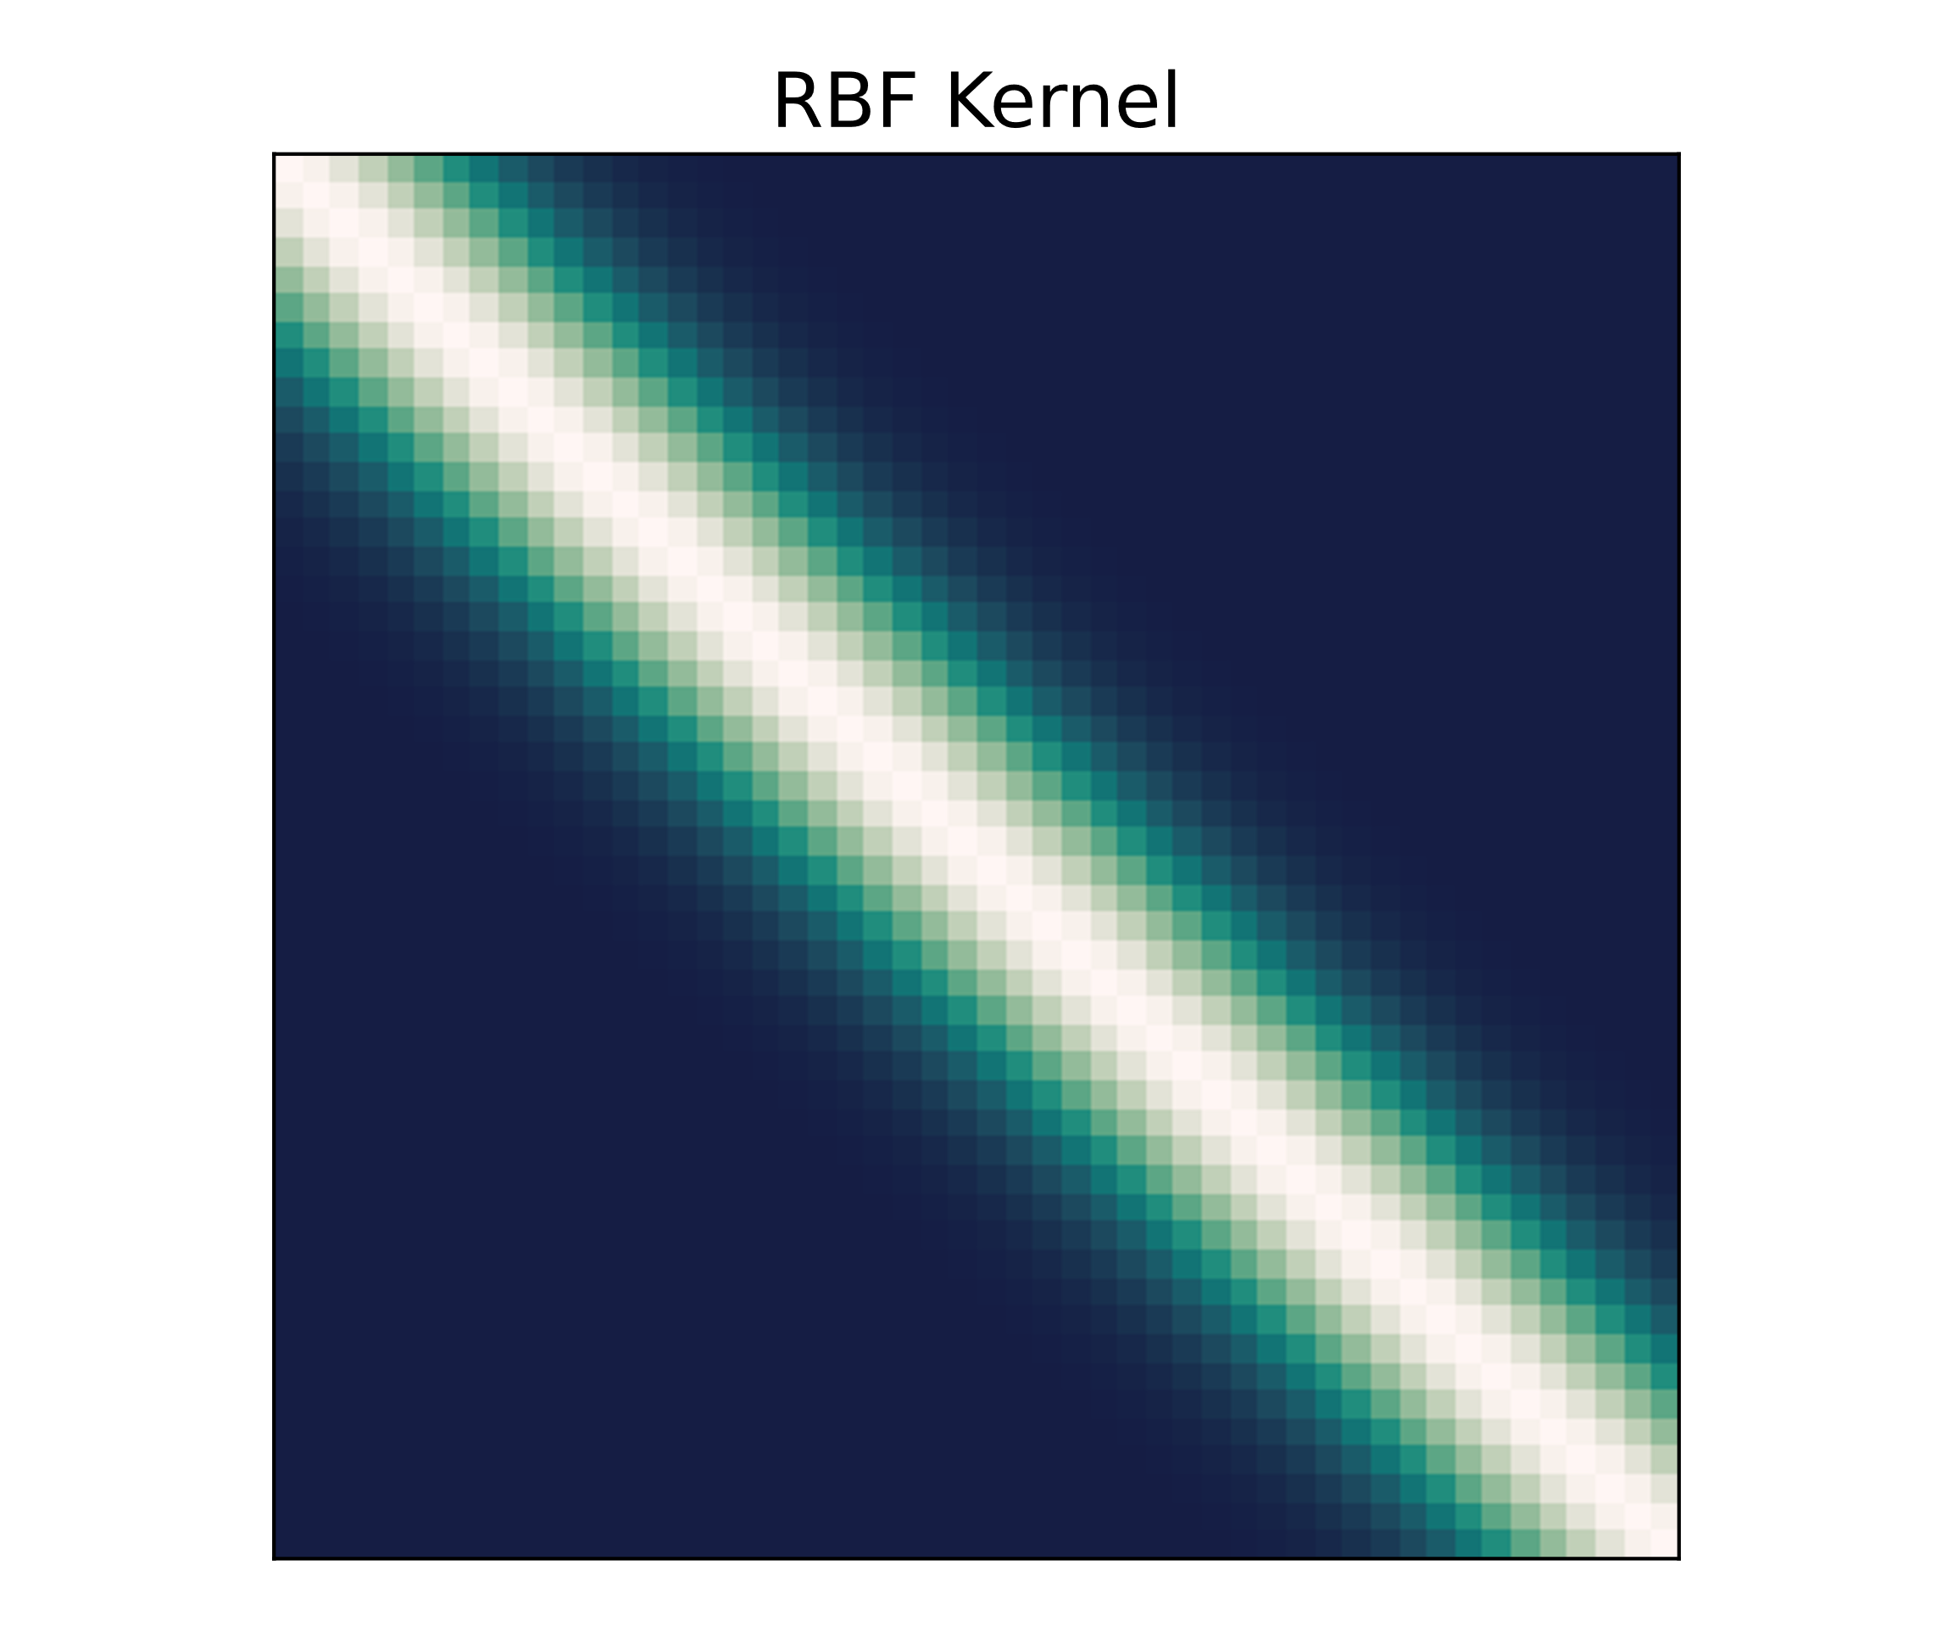
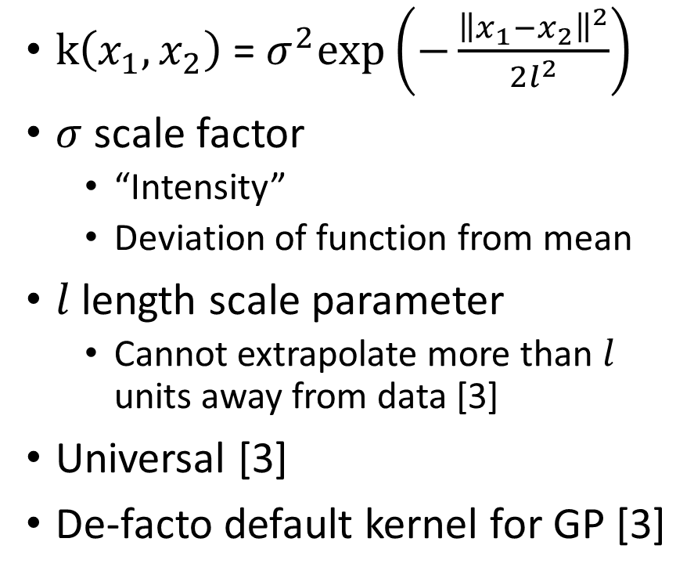
Kernels – RBF [2]
$\text{k}\left(x_{1},x_{2}\right) \text{=} σ^{2}\text{exp}\left(−\frac{{\left\|x_{1}−x_{2}\right\|}^{2}}{2l^{2}}\right)$
$σ$ scale factor
“Intensity”
Deviation of function from mean
$l$ length scale parameter
Cannot extrapolate more than $l$ units away from data [3]
Universal [3]
De-facto default kernel for GP [3]
Notes:
$σ$ and l are hyper parameters that one neets to choose, alter also hyperparameters
Difference in compact support or infinit – compact support ownly in lengthscale l meaniningfull prediction possible

Slide 12
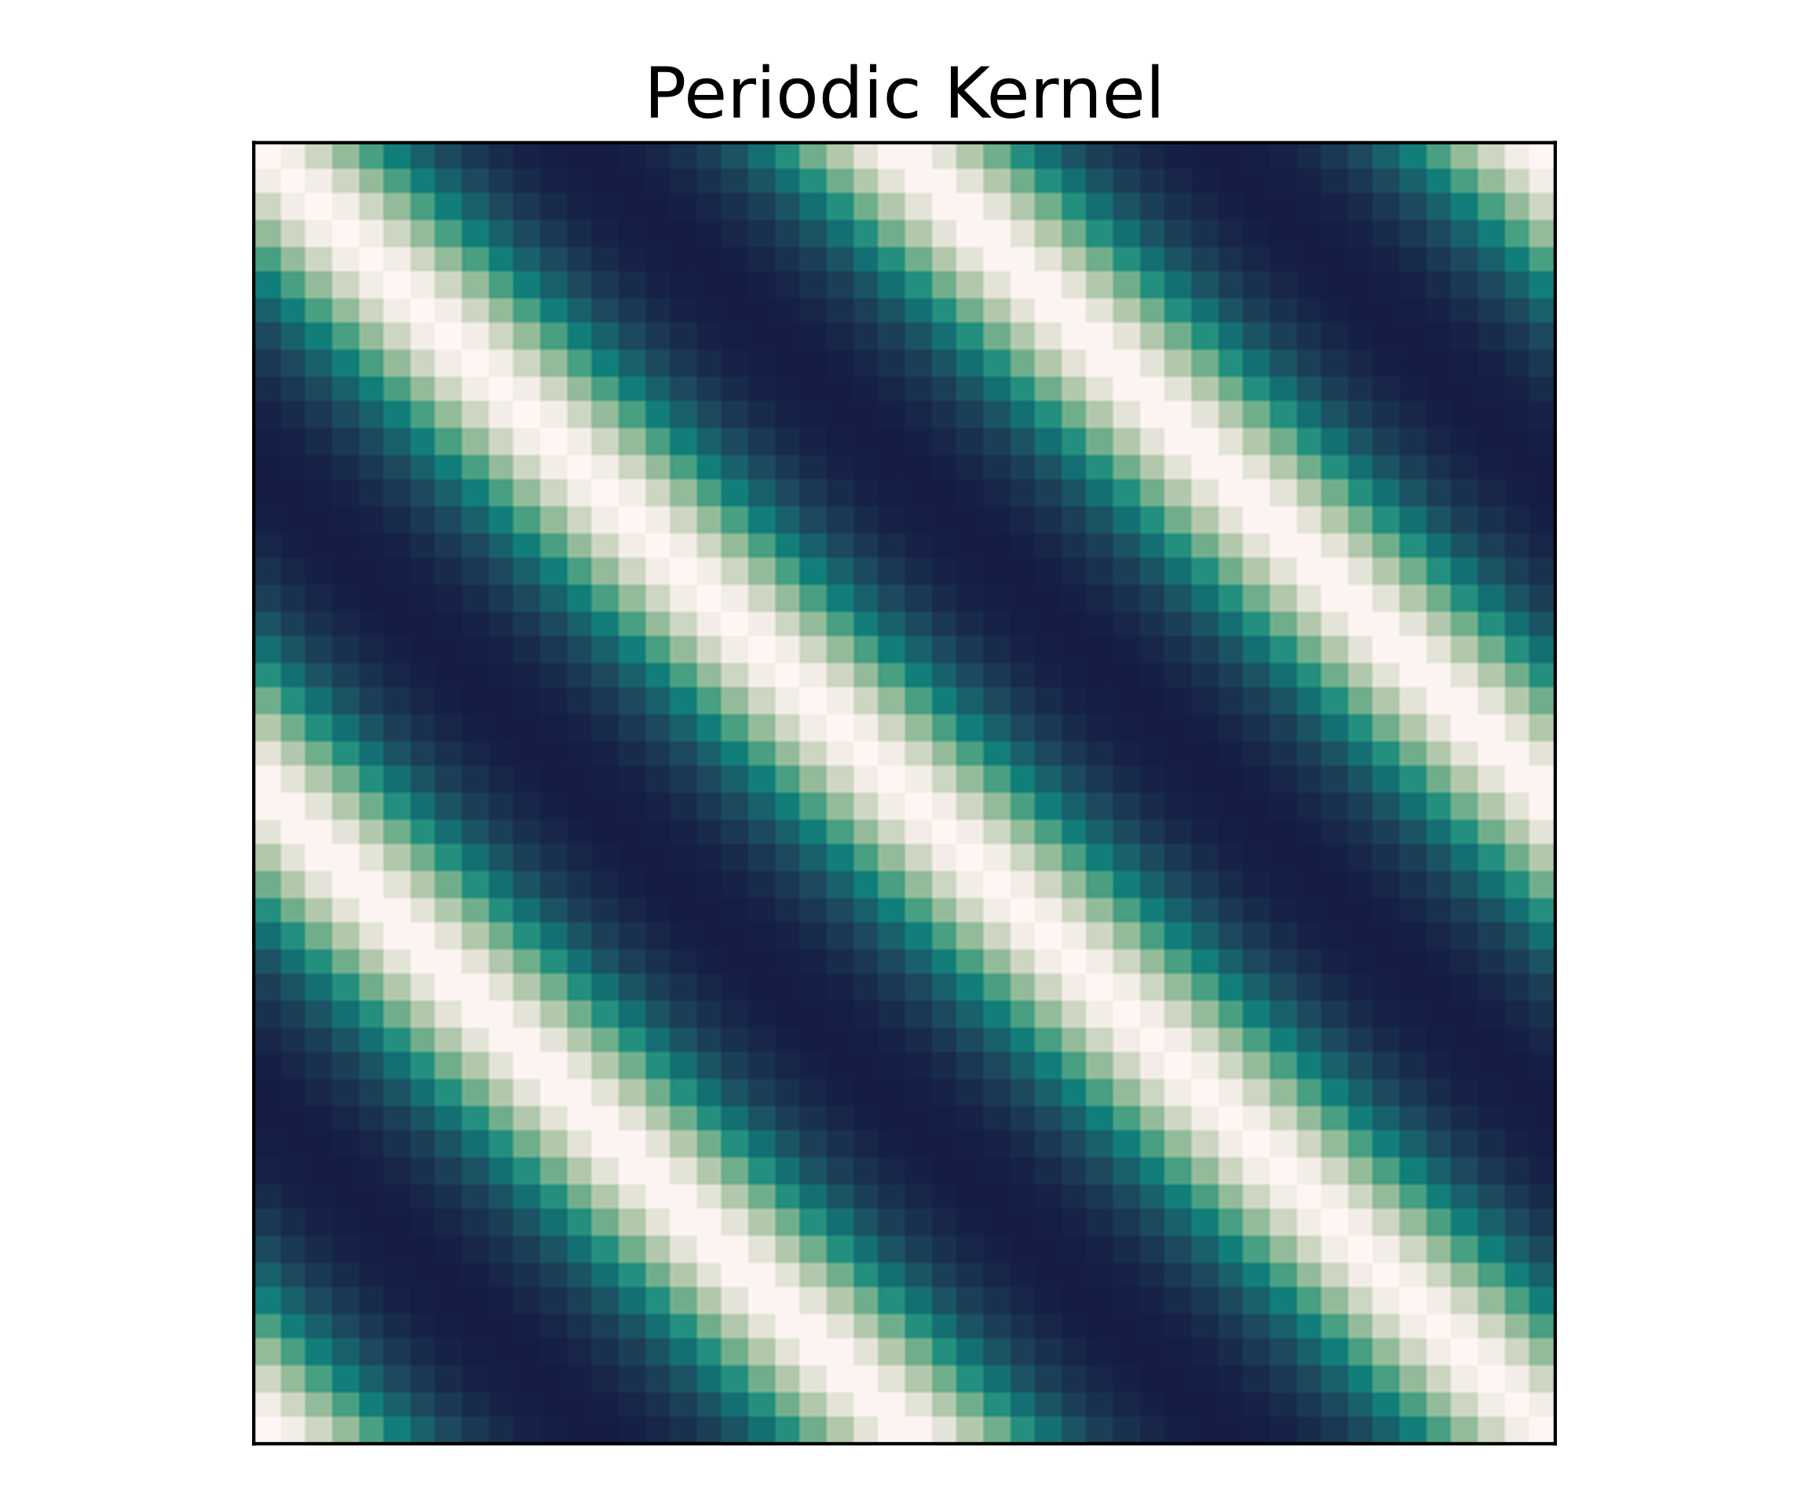
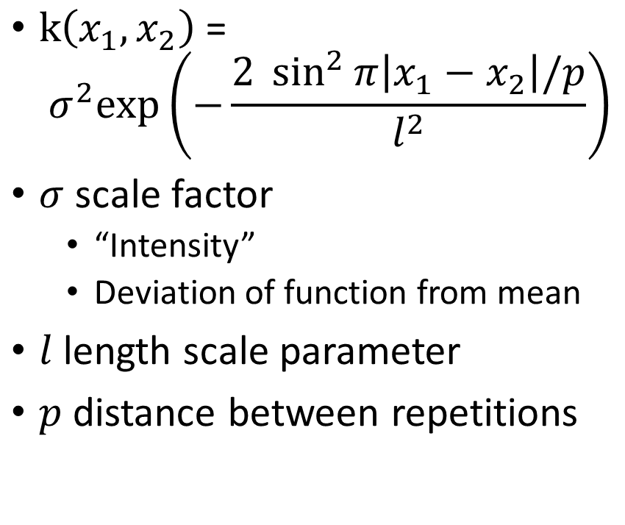
Kernels – Periodic [2]
$\text{k}\left(x_{1},x_{2}\right) \text{=}$ ${ σ}^{2}\text{exp}\left(−\frac{2 \sin^{2}{π\left|x_{1}−x_{2}\right|/p}}{l^{2}}\right)$
$σ$ scale factor
“Intensity”
Deviation of function from mean
$l$ length scale parameter
$p$ distance between repetitions

Slide 13
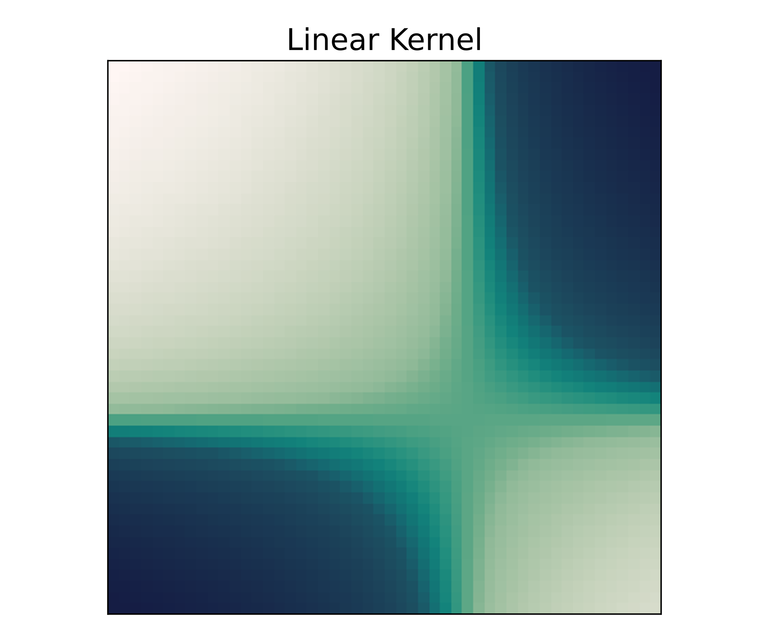
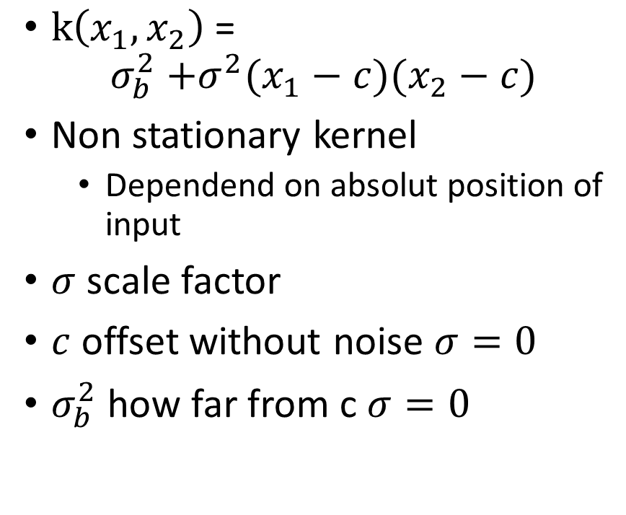
Kernels – Linear [2,3]
$\text{k}\left(x_{1},x_{2}\right) \text{=}$ $σ_{b}^{2}\text{ +}σ^{2}(x_{1}−c)(x_{2}−c)$
Non stationary kernel
Dependend on absolut position of input
$σ$ scale factor
$c$ offset without noise $σ=0$
$σ_{b}^{2}$ how far from c $σ=0$

Slide 14
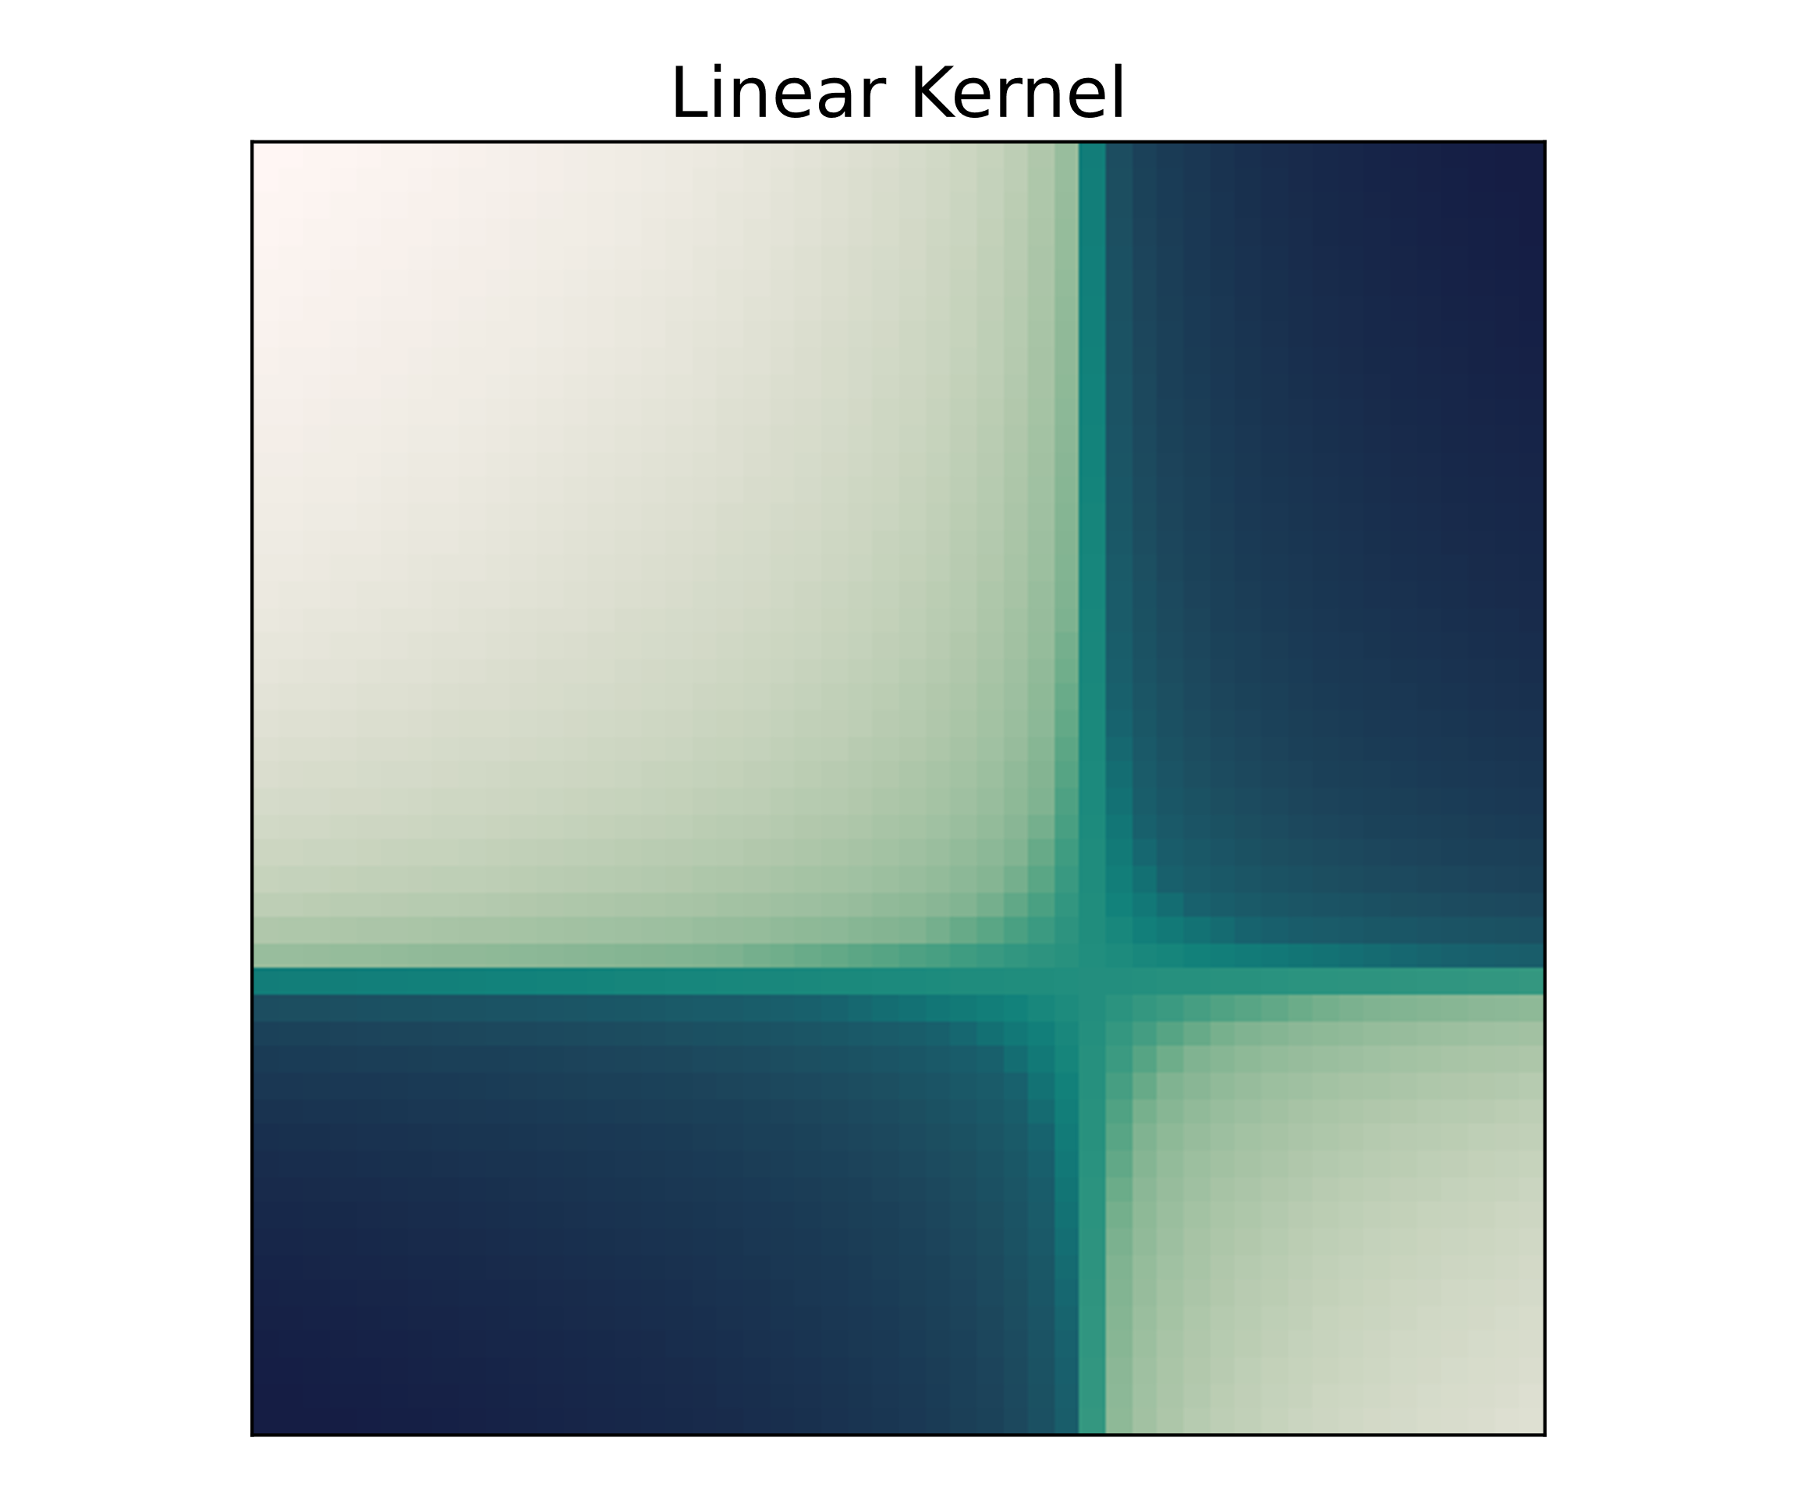
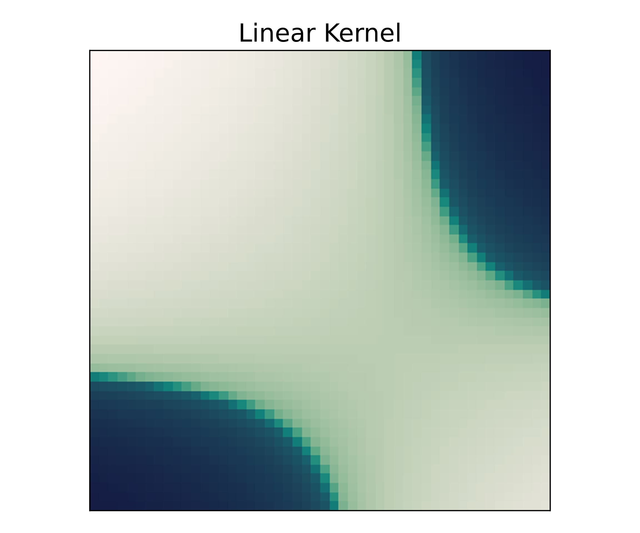


Kernels – Linear
$$σ_{b}=0, c=3,σ=1$$
$$σ_{b}=4, c=3,σ=1$$

Slide 15
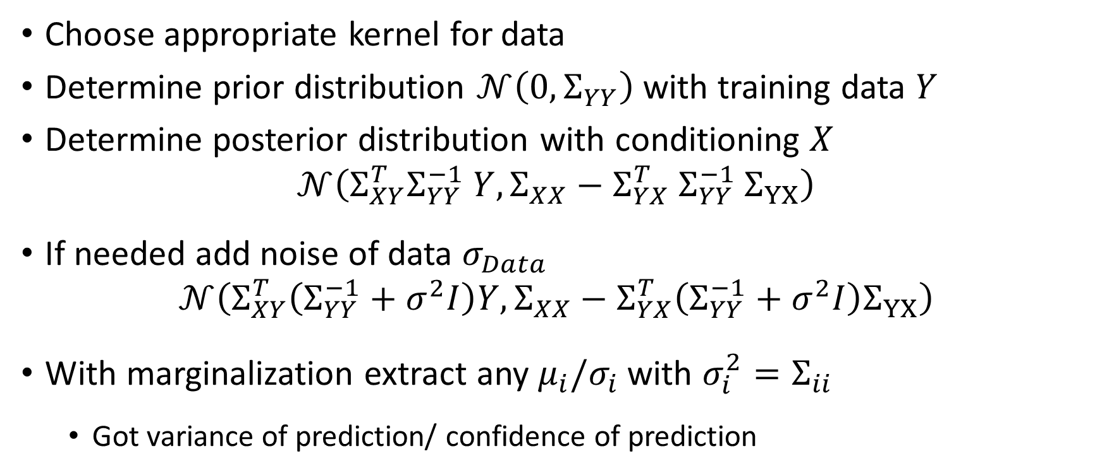
Regression as GP recipe [1,2]
Choose appropriate kernel for data
Determine prior distribution $𝒩\left(0, Σ_{YY}\right)$ with training data $Y$
Determine posterior distribution with conditioning $X$
$$𝒩\left(Σ_{XY}^{T}Σ_{YY}^{−1} Y, Σ_{XX}−Σ_{YX}^{T} Σ_{YY}^{−1} Σ_{YX}\right)$$
If needed add noise of data $σ_{Data}$
$$𝒩\left(Σ_{XY}^{T}\left(Σ_{YY}^{−1}+σ^{2}I\right)Y, Σ_{XX}−Σ_{YX}^{T}\left(Σ_{YY}^{−1}+σ^{2}I\right)Σ_{YX}\right)$$
With marginalization extract any $μ_{i}/σ_{i}$ with $σ_{i}^{2}=Σ_{ii}$
Got variance of prediction/ confidence of prediction

Slide 16
Live coding

Slide 17
Deep Neural Networks as GP

Slide 18
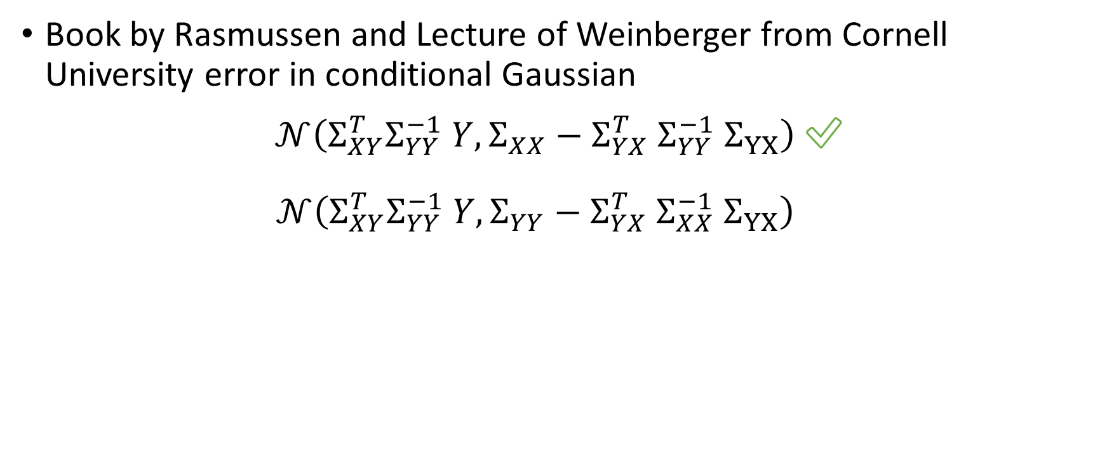
Conclusion - Caveats
Book by Rasmussen and Lecture of Weinberger from Cornell University error in conditional Gaussian
$𝒩\left(Σ_{XY}^{T}Σ_{YY}^{−1} Y, Σ_{XX}−Σ_{YX}^{T} Σ_{YY}^{−1} Σ_{YX}\right)$ ✅
$𝒩\left(Σ_{XY}^{T}Σ_{YY}^{−1} Y, Σ_{YY}−Σ_{YX}^{T} Σ_{XX}^{−1} Σ_{YX}\right)$ ✅

Slide 19
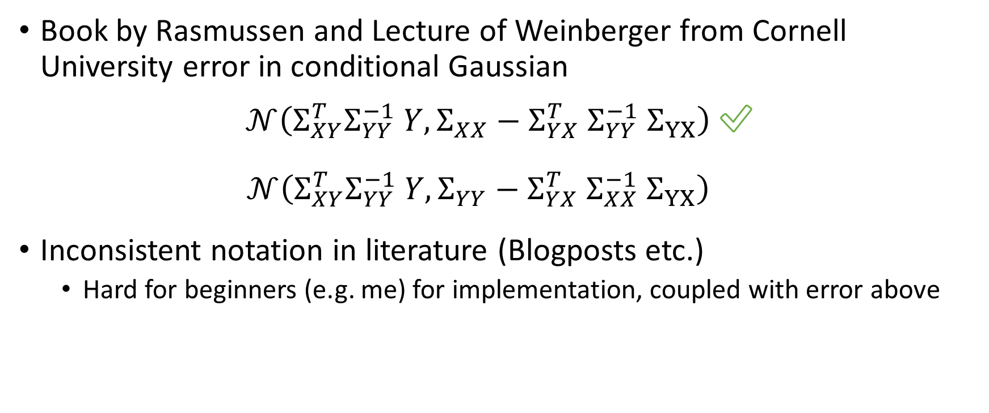
Conclusion - Caveats
Book by Rasmussen and Lecture of Weinberger from Cornell University error in conditional Gaussian
$𝒩\left(Σ_{XY}^{T}Σ_{YY}^{−1} Y, Σ_{XX}−Σ_{YX}^{T} Σ_{YY}^{−1} Σ_{YX}\right)$ ✅
$𝒩\left(Σ_{XY}^{T}Σ_{YY}^{−1} Y, Σ_{YY}−Σ_{YX}^{T} Σ_{XX}^{−1} Σ_{YX}\right)$ ✅
Inconsistent notation in literature (Blogposts etc.)
Hard for beginners (e.g. me) for implementation, coupled with error above

Slide 20
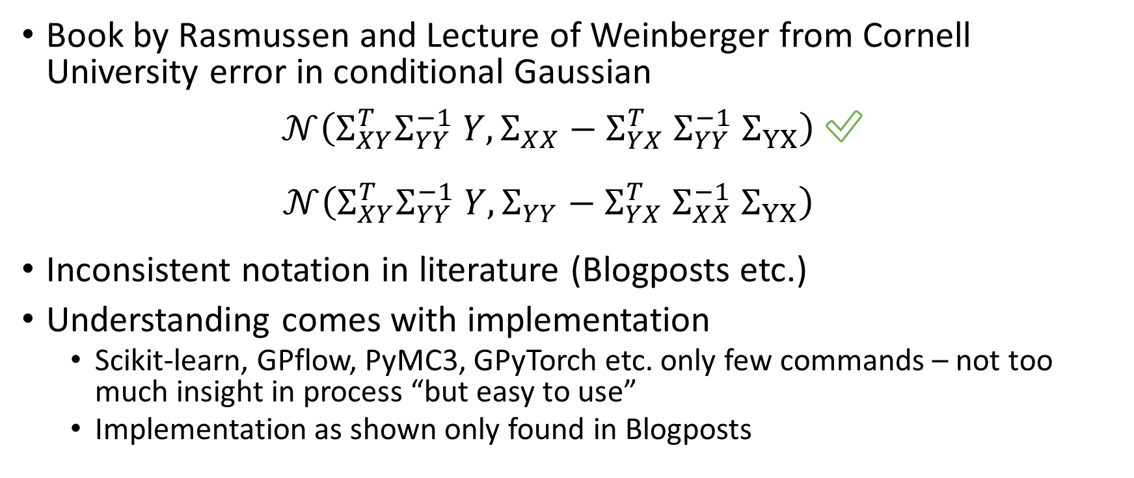
Conclusion - Caveats
Book by Rasmussen and Lecture of Weinberger from Cornell University error in conditional Gaussian
$𝒩\left(Σ_{XY}^{T}Σ_{YY}^{−1} Y, Σ_{XX}−Σ_{YX}^{T} Σ_{YY}^{−1} Σ_{YX}\right)$ ✅
$𝒩\left(Σ_{XY}^{T}Σ_{YY}^{−1} Y, Σ_{YY}−Σ_{YX}^{T} Σ_{XX}^{−1} Σ_{YX}\right)$ ✅
Inconsistent notation in literature (Blogposts etc.)
Understanding comes with implementation
Scikit-learn, GPflow, PyMC3, GPyTorch etc. only few commands – not too much insight in process “but easy to use”
Implementation as shown only found in Blogposts

Slide 21
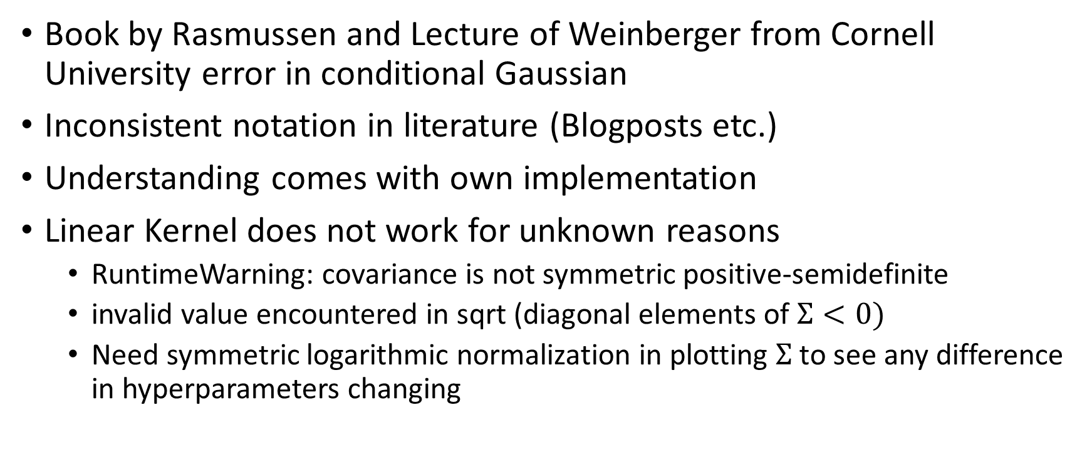
Conclusion - Caveats
Book by Rasmussen and Lecture of Weinberger from Cornell University error in conditional Gaussian✅
Inconsistent notation in literature (Blogposts etc.)
Understanding comes with own implementation
Linear Kernel does not work for unknown reasons
RuntimeWarning: covariance is not symmetric positive-semidefinite
invalid value encountered in sqrt (diagonal elements of $Σ<0)$
Need symmetric logarithmic normalization in plotting $Σ$ to see any difference in hyperparameters changing
Notes:
“If you use just a linear kernel in a GP, you're simply doing Bayesian linear regression, and good news! You can do this in time O(N) instead of O(N3), so you should probably go use software specifically designed for that. “[3]

Slide 22
Conclusion - Caveats
Book by Rasmussen and Lecture of Weinberger from Cornell University error in conditional Gaussian✅
Inconsistent notation in literature (Blogposts etc.)
Understanding comes with own implementation
Linear Kernel does not work for unknown reasons
Concept of test / training data gets smeared due to Bayesian inference

Slide 23
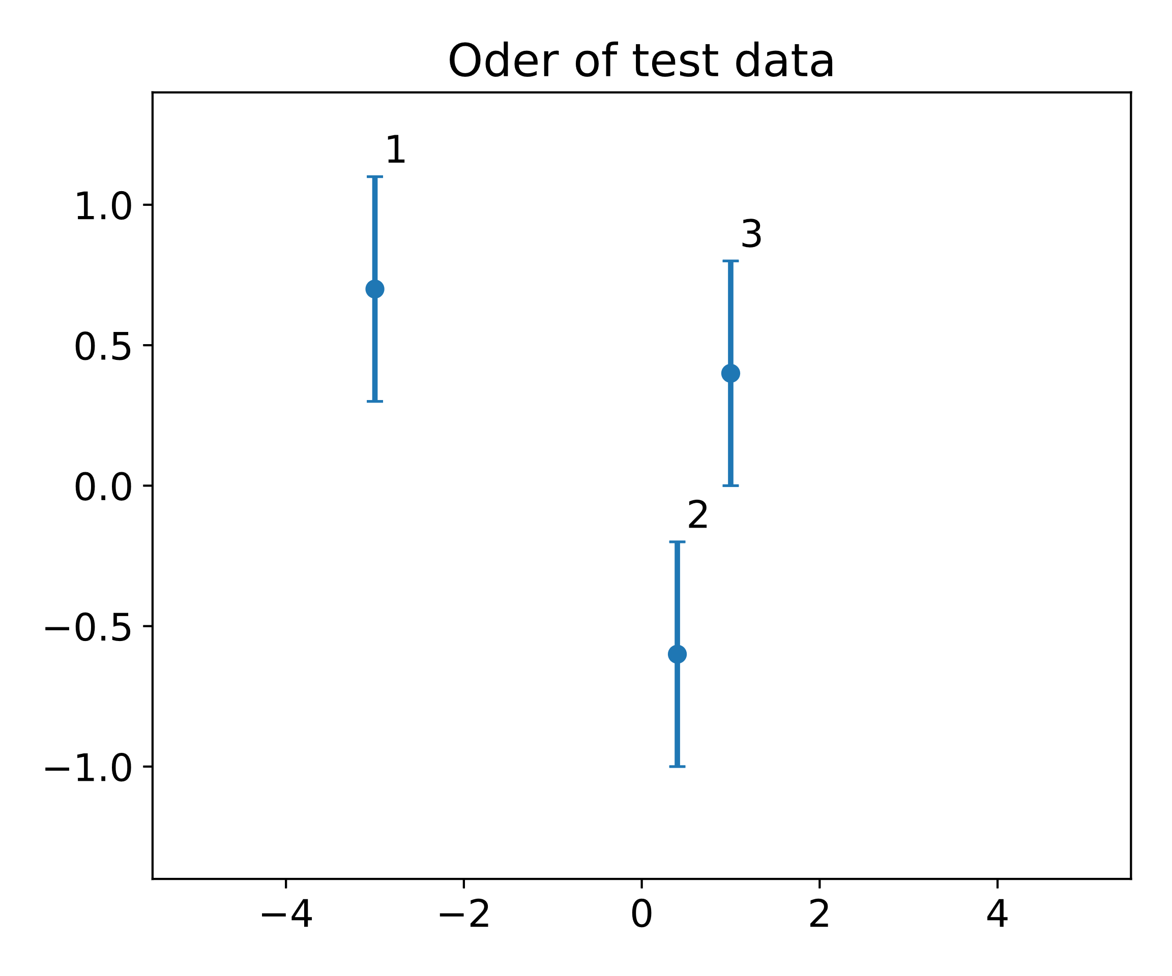
Conclusion – Caveats – Test and Training Data
Concept of test / training data gets smeared
Adding more test data “old” test data gets training data

Slide 24
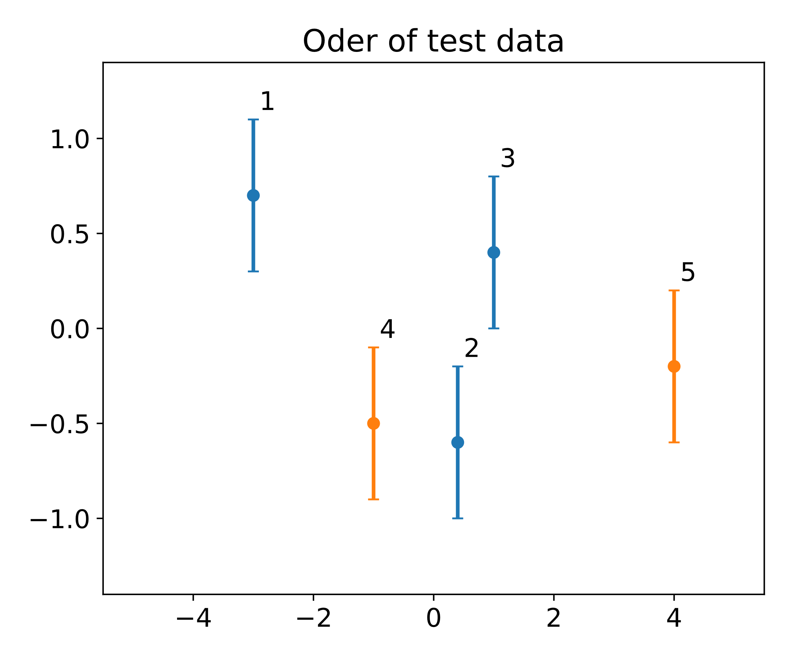
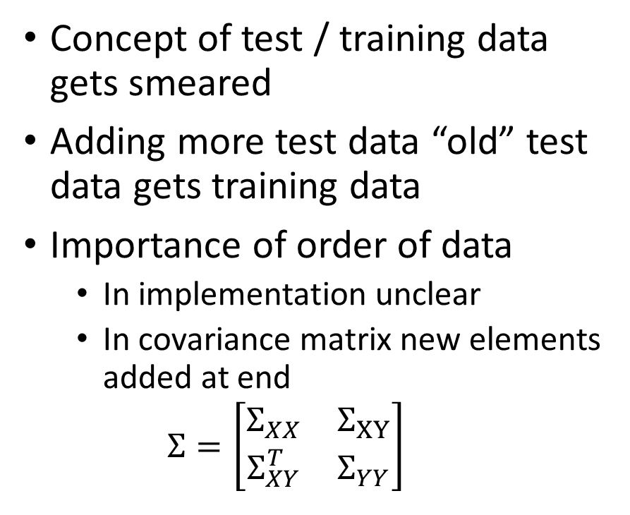
Conclusion – Caveats – Test and Training Data
Concept of test / training data gets smeared
Adding more test data “old” test data gets training data
Importance of order of data
In implementation unclear
In covariance matrix new elements added at end
$$Σ=\left[\begin{matrix}Σ_{XX} & Σ_{XY} \\ Σ_{XY}^{T} & Σ_{YY}\end{matrix}\right]$$

Slide 25
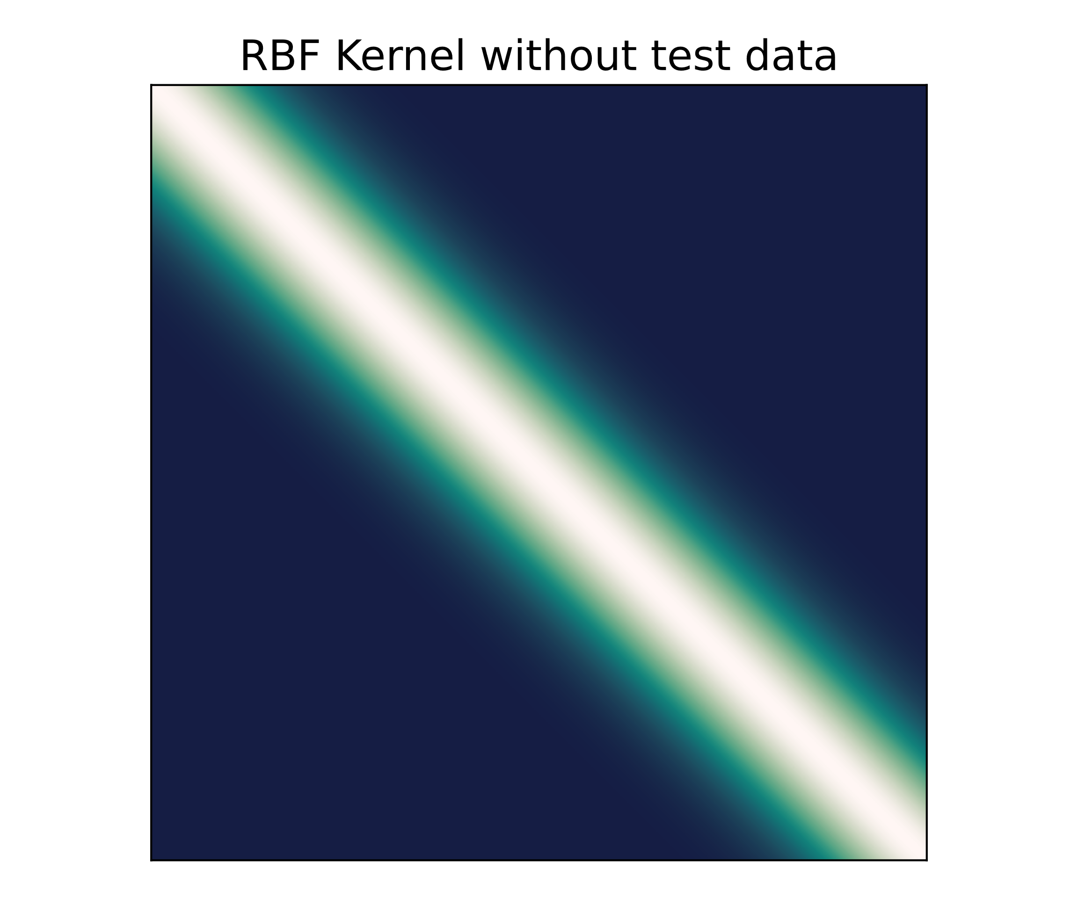
Conclusion – Caveats – Test and Training Data
Concept of test / training data gets smeared
Adding more test data “old” test data gets training data
Importance of order of data
In implementation unclear
In covariance matrix new elements added at end
$$Σ=\left[\begin{matrix}Σ_{XX} & Σ_{XY} \\ Σ_{XY}^{T} & Σ_{YY}\end{matrix}\right]$$

Slide 26
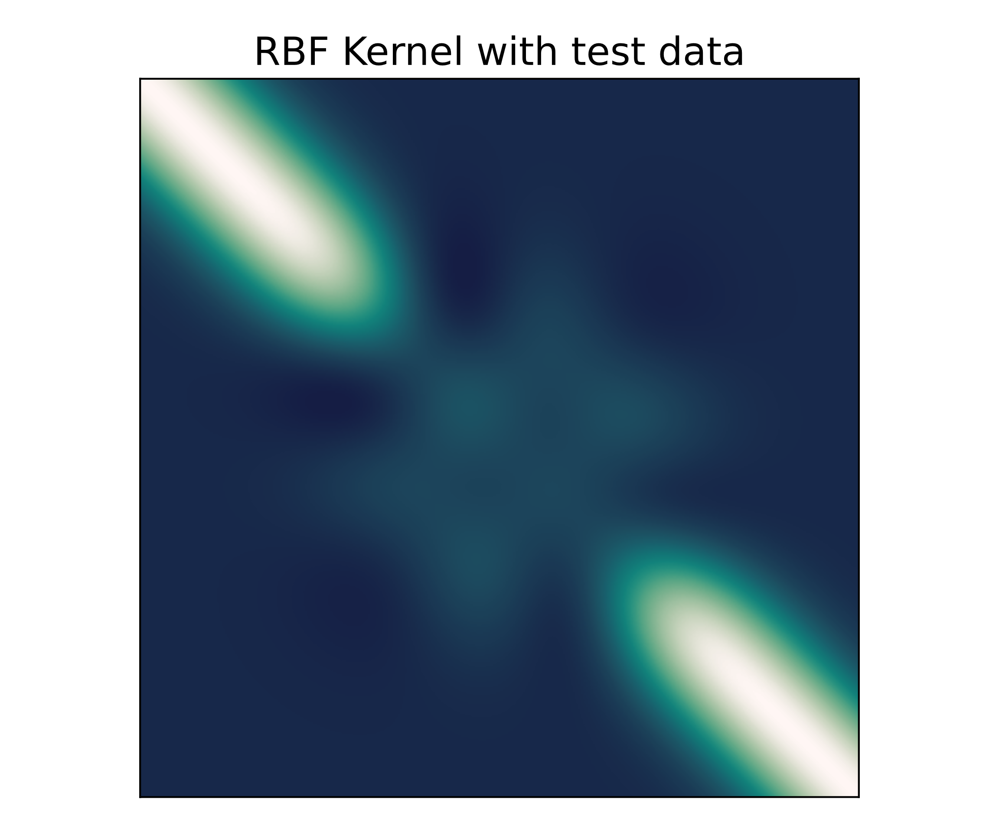
Conclusion – Caveats – Test and Training Data
Concept of test / training data gets smeared
Adding more test data “old” test data gets training data
Importance of order of data
In implementation unclear
In covariance matrix new elements added at end
$$Σ=\left[\begin{matrix}Σ_{XX} & Σ_{XY} \\ Σ_{XY}^{T} & Σ_{YY}\end{matrix}\right]$$

Slide 27
Conclusion - Caveats
Book by Rasmussen and Lecture of Weinberger from Cornell University error in conditional Gaussian✅
Inconsistent notation in literature (Blogposts etc.)
Understanding comes with own implementation
Linear Kernel does not work for unknown reasons
Concept of test / training data gets smeared due to Bayesian inference
“Two approaches”
1) Start with x-Axis -> add measurement data -> get predictions from x-Axis
2) Start with measurement -> add x-Axis -> get predictions from x-Axis

Slide 28
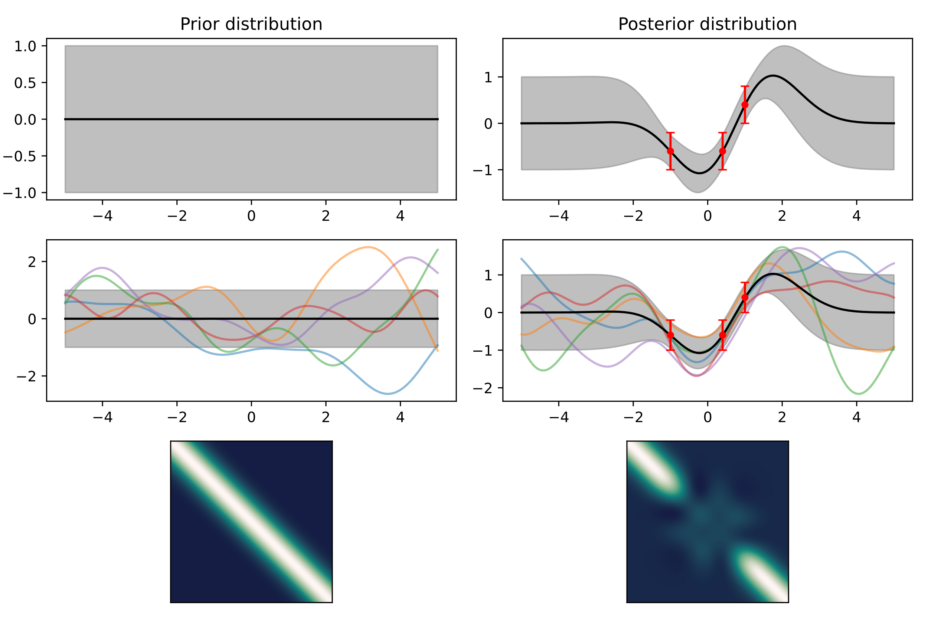
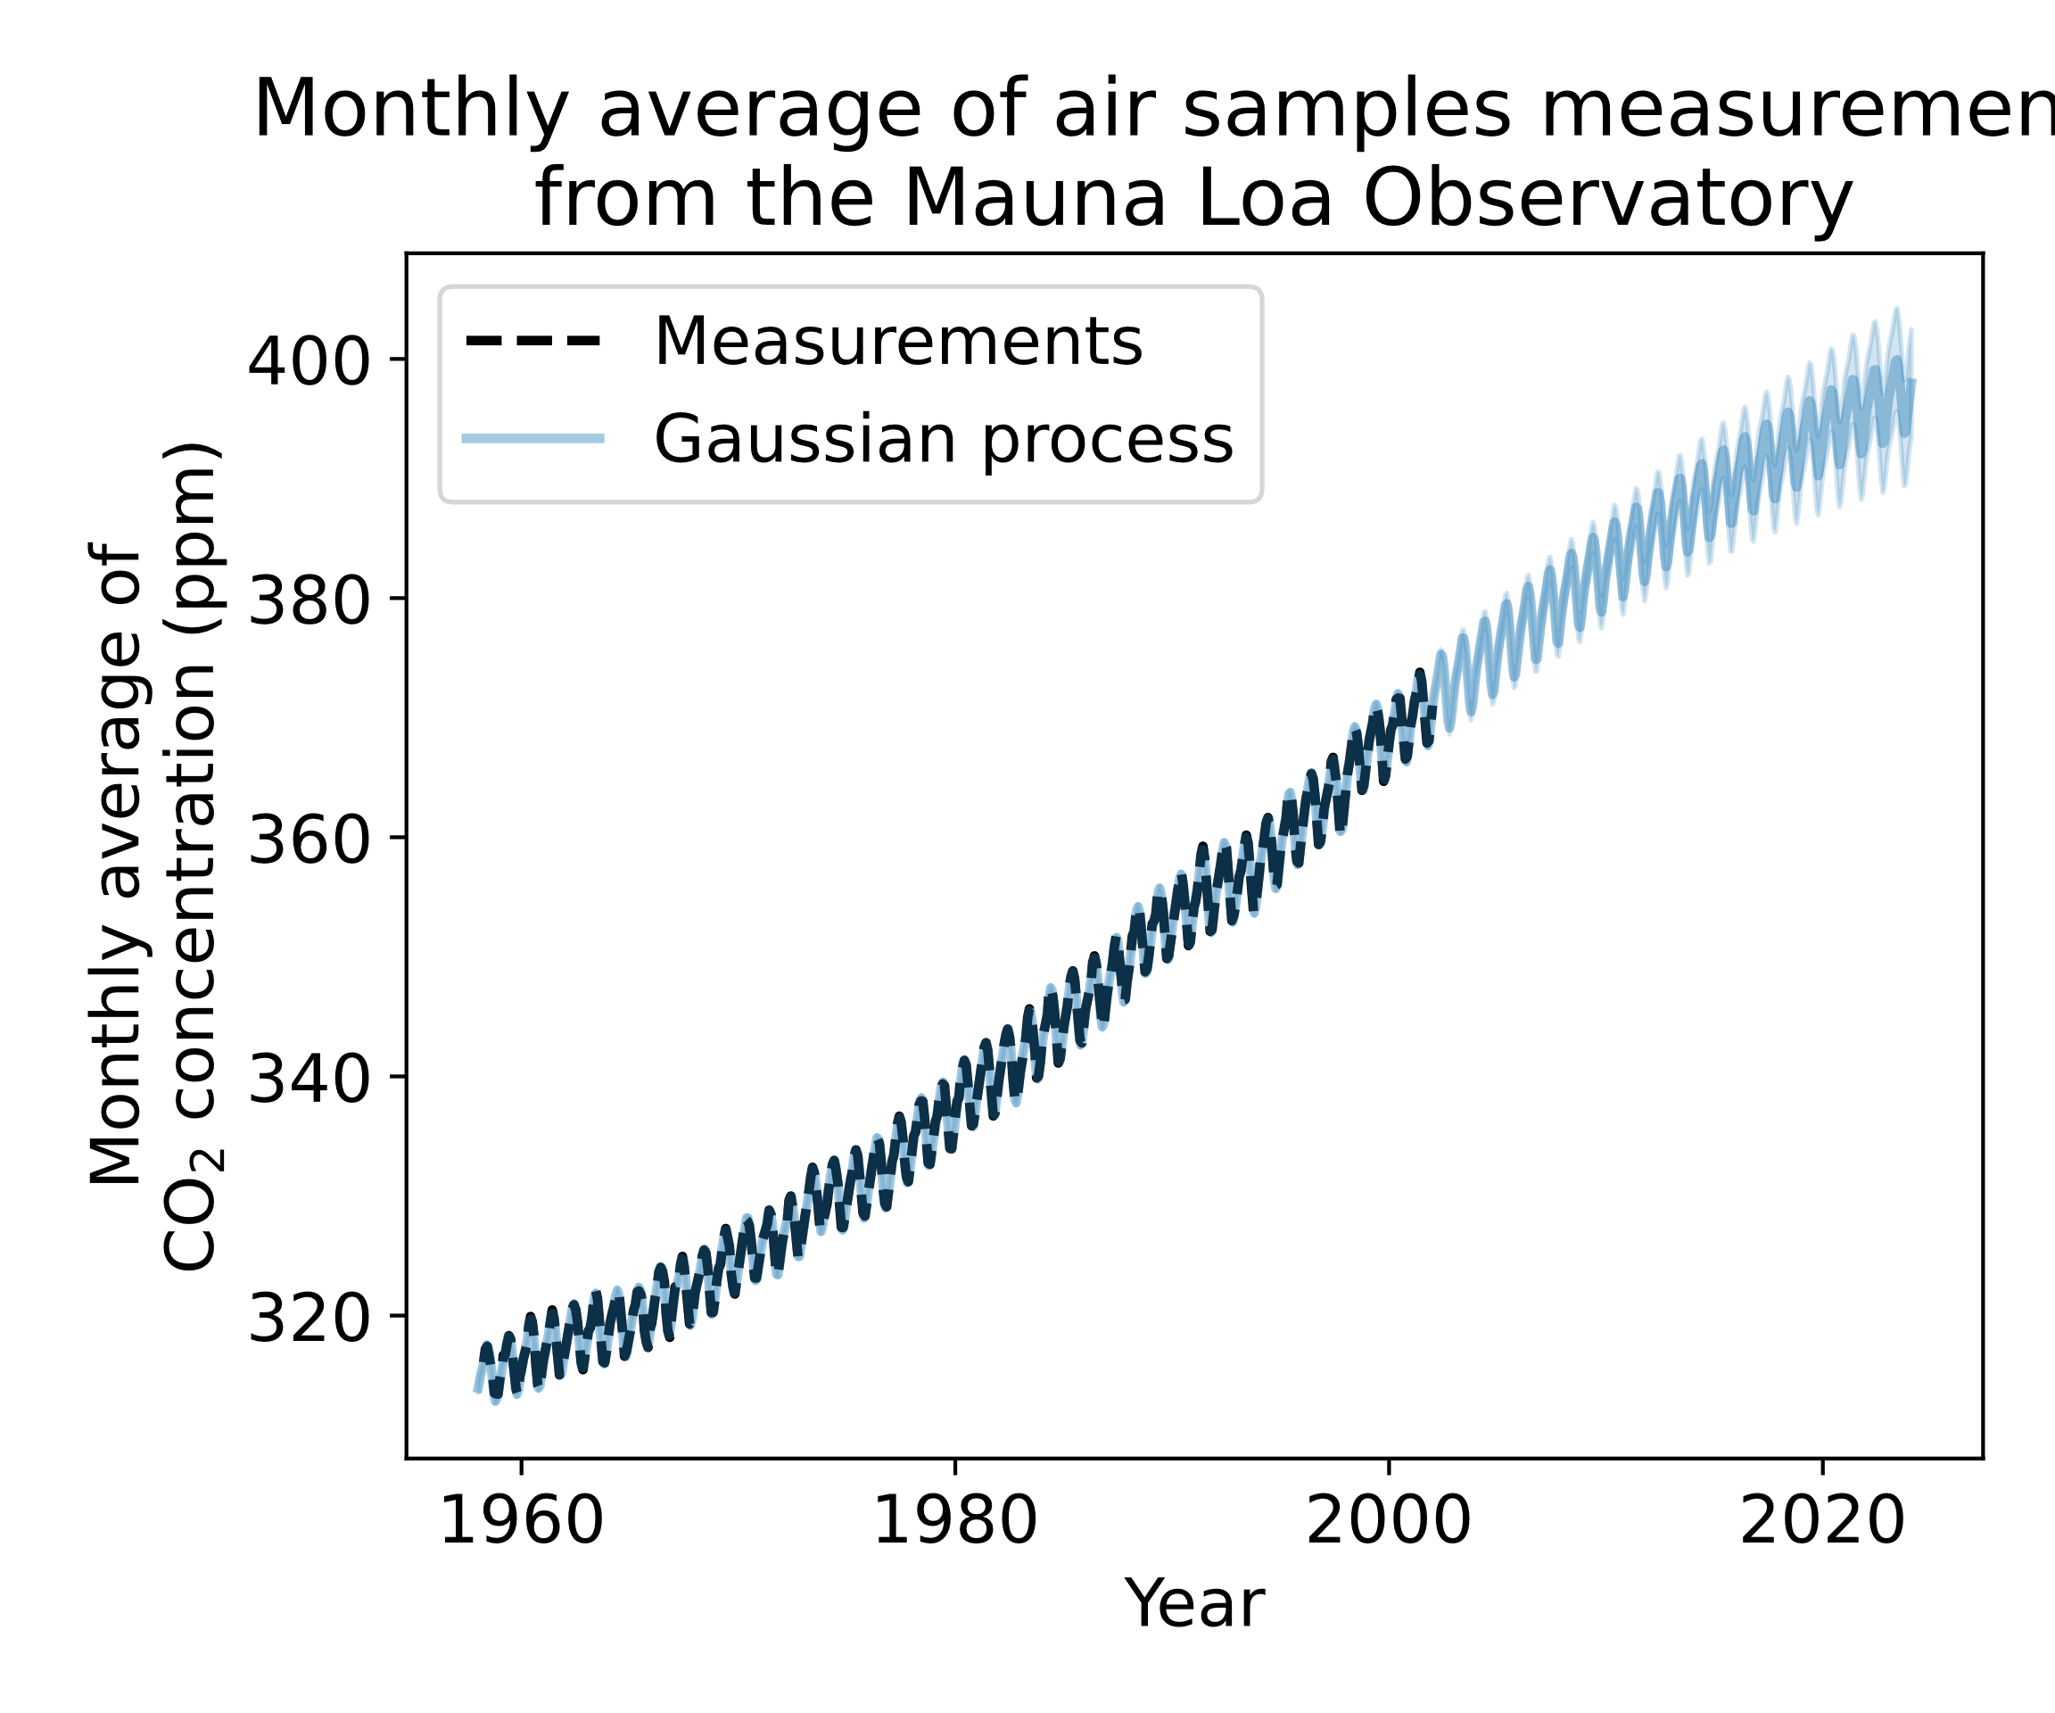
Conclusion – Caveats – “Two approaches”
Approach 1
Approach 2
[4]
Notes:
Approach 1) not totally clear where to implement hyperparameter optimization!
Approach 2) follows more the classical way of fitting data

Slide 29
Conclusion - Caveats
Book by Rasmussen and Lecture of Weinberger from Cornell University error in conditional Gaussian✅
Inconsistent notation in literature (Blogposts etc.)
Understanding comes with own implementation
Linear Kernel does not work for unknown reasons
Concept of test / training data gets smeared due to Bayesian inference
“Two approaches”
Hypotheses testing lost?

Slide 30
Conclusion
Conceptionally straightforward
Applications many fields possible
Lot of Caveats – especially in implementation
Inefficient for huge datasets [1]
Hypotheses testing lost?
Kernel choice needs good knowledge of data [3]
Notes:
Huge here not specified

Slide 31
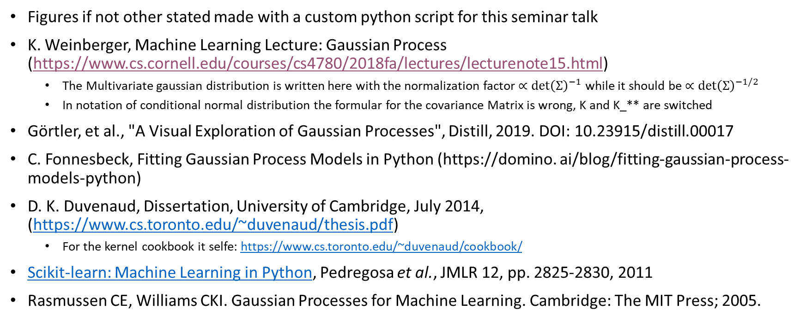
Sources
Figures if not other stated made with a custom python script for this seminar talk
K. Weinberger, Machine Learning Lecture: Gaussian Process (https://www.cs.cornell.edu/courses/cs4780/2018fa/lectures/lecturenote15.html)
The Multivariate gaussian distribution is written here with the normalization factor $∝\det{{\left(Σ\right)}^{−1}}$ while it should be $∝\det{{\left(Σ\right)}^{−1/2}}$
In notation of conditional normal distribution the formular for the covariance Matrix is wrong, K and K_** are switched
Görtler, et al., "A Visual Exploration of Gaussian Processes", Distill, 2019. DOI: 10.23915/distill.00017
C. Fonnesbeck, Fitting Gaussian Process Models in Python (https://domino. ai/blog/fitting-gaussian-process-models-python)
D. K. Duvenaud, Dissertation, University of Cambridge, July 2014, (https://www.cs.toronto.edu/~duvenaud/thesis.pdf)
For the kernel cookbook it selfe: https://www.cs.toronto.edu/~duvenaud/cookbook/
Scikit-learn: Machine Learning in Python, Pedregosa et al., JMLR 12, pp. 2825-2830, 2011
Rasmussen CE, Williams CKI. Gaussian Processes for Machine Learning. Cambridge: The MIT Press; 2005.

